Slide 2
Reinventing the future of LED work lights
SCANGRIP is taking an ambitious strategic step forward by committing to develop LED work lights with minimized environmental impact while at the same time improving energy efficiency and expanding the lifespan.
13 of our premium, top-selling LED work lights are being reintroduced.

Slide 3
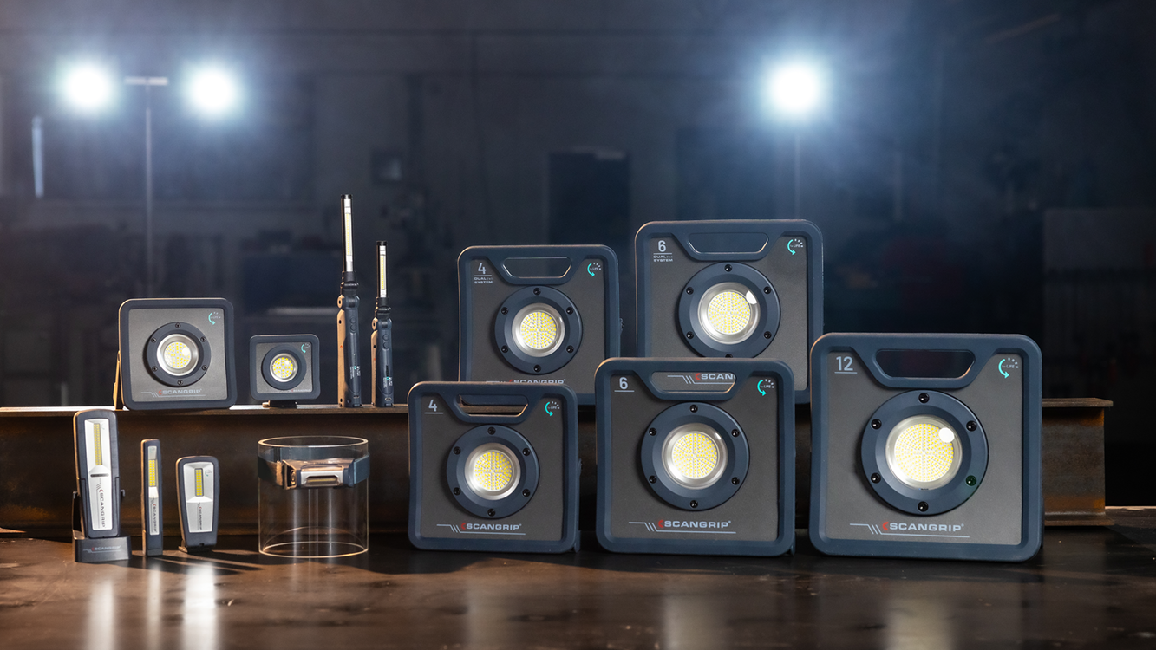

Slide 4
Setting new standards
Commitment to creating premium, innovative LED work lights.
Focus on prolonging the products' lifespan as the most effective approach to reducing environmental impact.
Creating work lights of tomorrow with a brand-new perspective, rooted in technical specialist know-how and extensive experience.

Slide 5
FOR LIFE
The FOR LIFE concept represents a pioneering approach that focuses
on reinventing the design and functionality of LED work lights and optimize
energy efficiency to the utmost.
The key features that make these new LED work lights stand out:
Lifespan more than doubled
Highest energy efficiency
Maximized performance

Slide 6
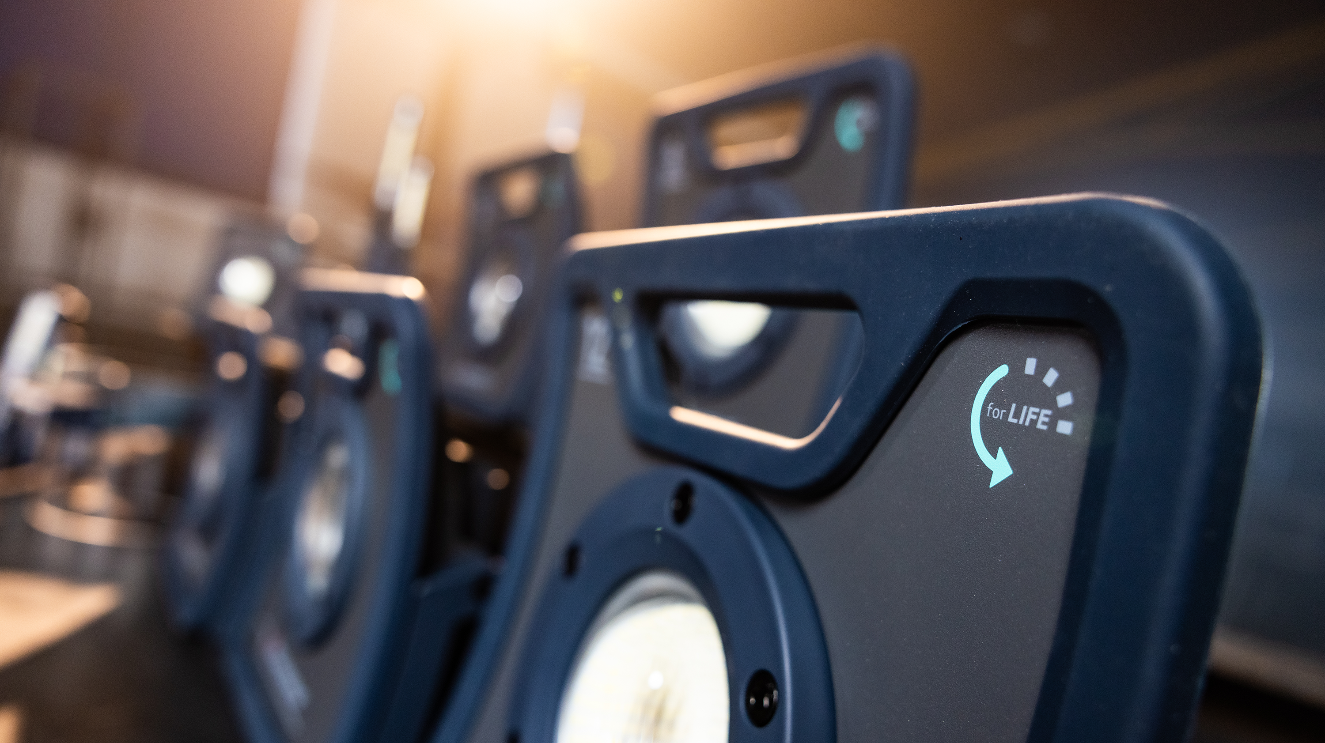

Slide 7
Lifespan more than doubled
The most effective way to reduce environmental impact is to prolong a product’s lifespan as much as possible. In comparison with the current lifetime of estimated 4 years, we have succeeded in extending the lifespan of the FOR LIFE products to 10 years, which results in a significant reduction of the overall environmental footprint.
10-year design life
Battery recharging lifespan doubled to 1000 cycles
Advanced battery temperature surveillance system
Improved electronic design for power supply
Refined electronic design for charging circuit
Spare parts available
Opting for spare part replacements prolongs product lifespan, reduces waste, and supports sustainability efforts.

Slide 8
Environmental impact over time

Slide 9
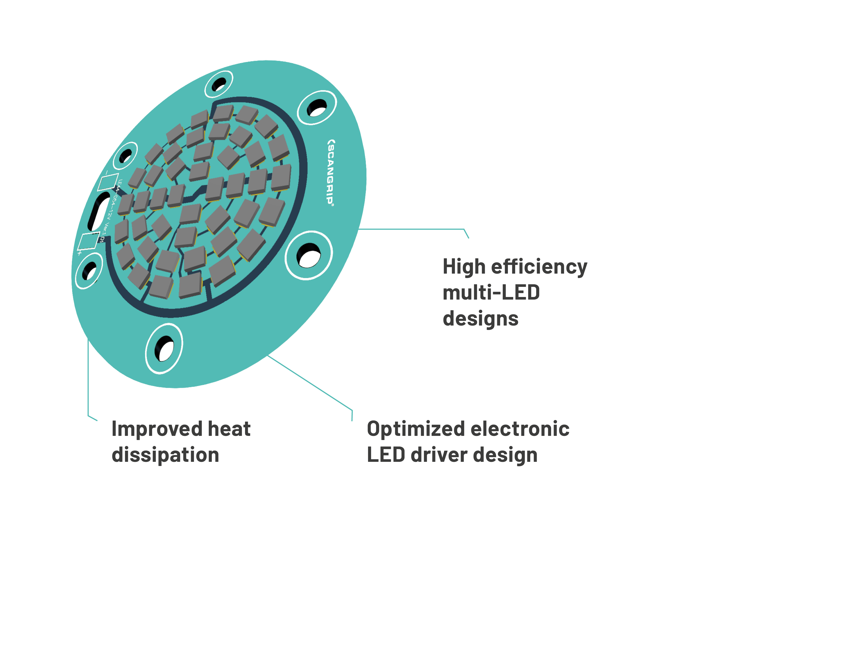
Highest energy efficiency
Remarkable energy savings achieved through attention to detail and utilization of the latest LED technology.

Slide 10
Maximized performance
SCANGRIP work lights are renowned for their exceptional luminosity and durability. Our commitment is to constantly enhance these already outstanding qualities without compromising on performance.

Slide 11
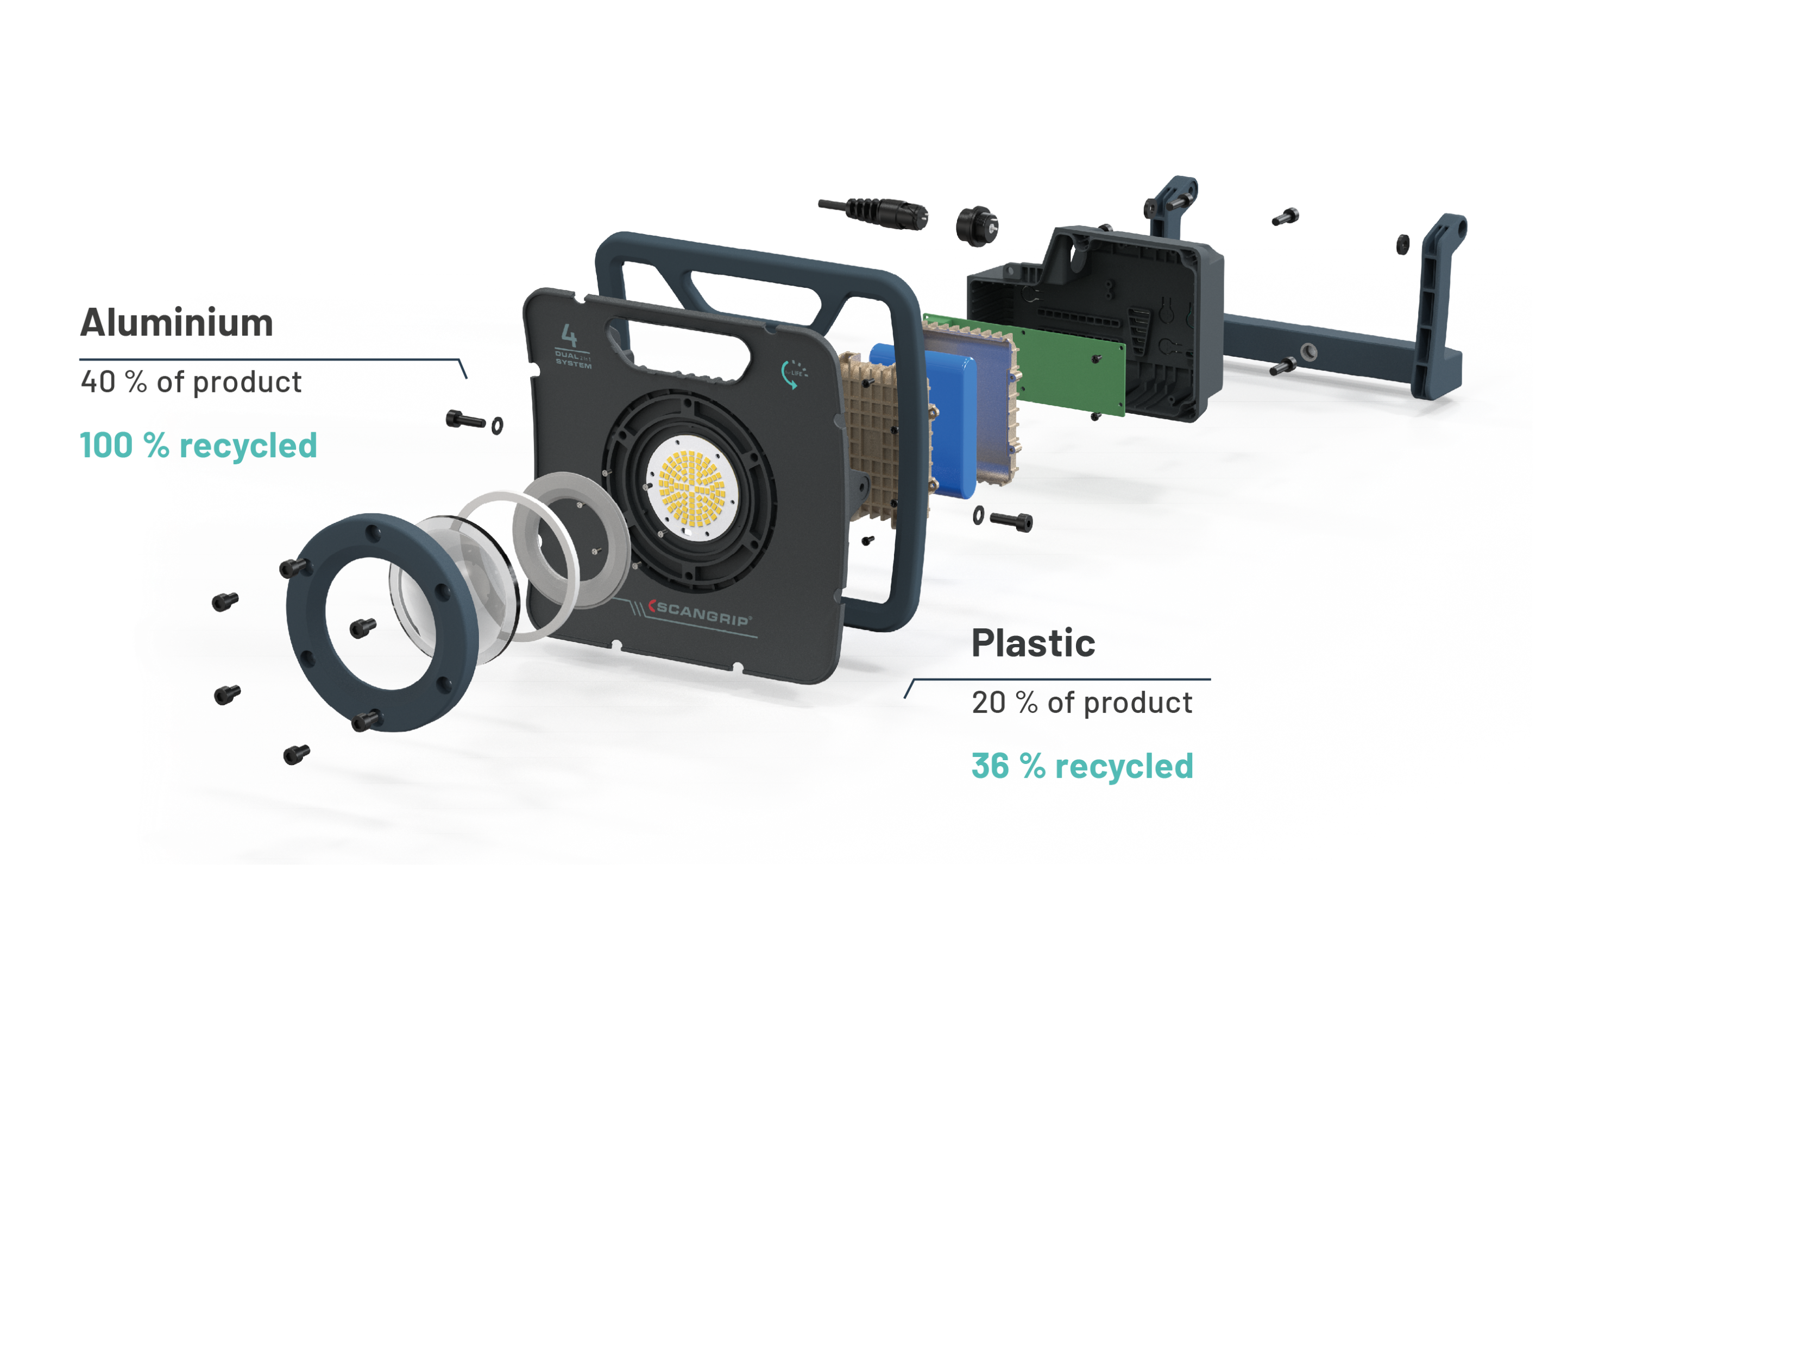
Recycled materials
Wherever physically possible, we have found ways to incorporate recycled materials into the design of the work lights.

Slide 12
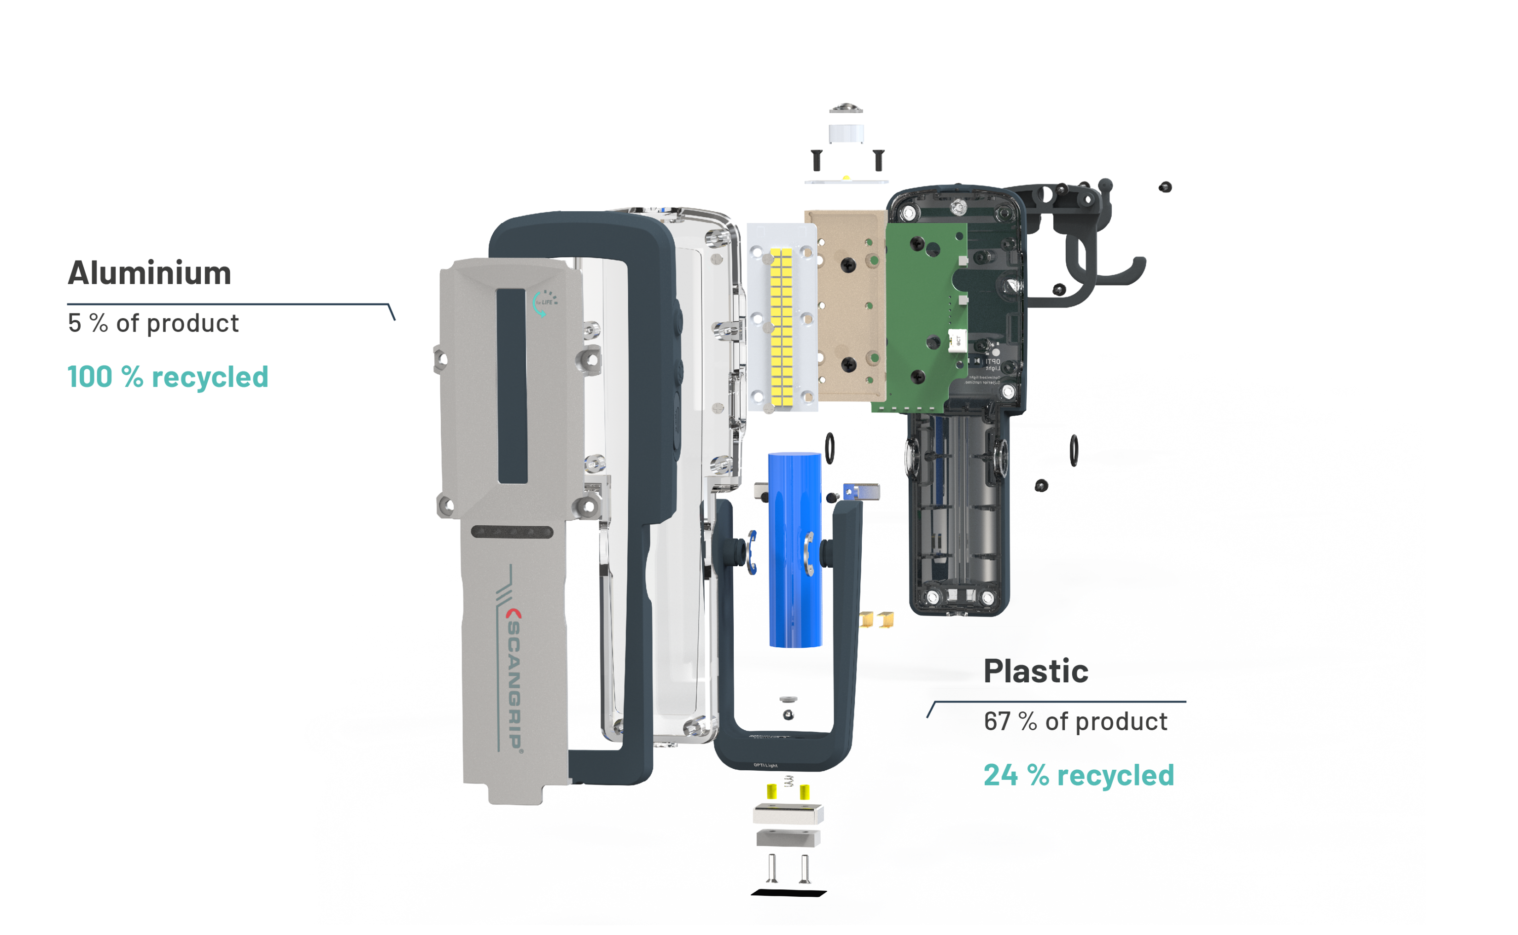
Recycled materials

Slide 13
5-year warranty
With the highest quality
Standards, the work lights come with an extraordinary 5-year warranty.
In addition to the normal 2-year warranty, FOR LIFE products are covered by a warranty extension of total 5 years. Register on scangrip.com.

Slide 14
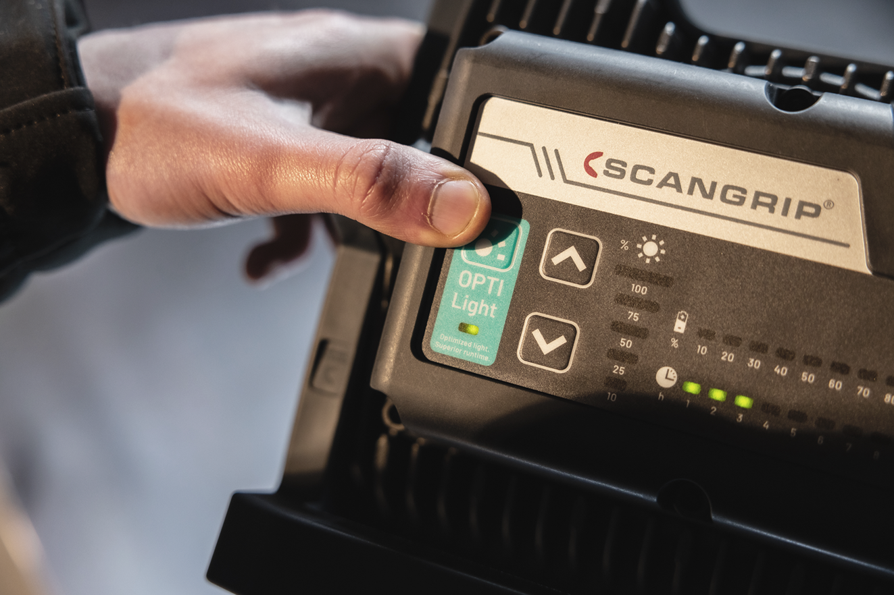

Slide 15
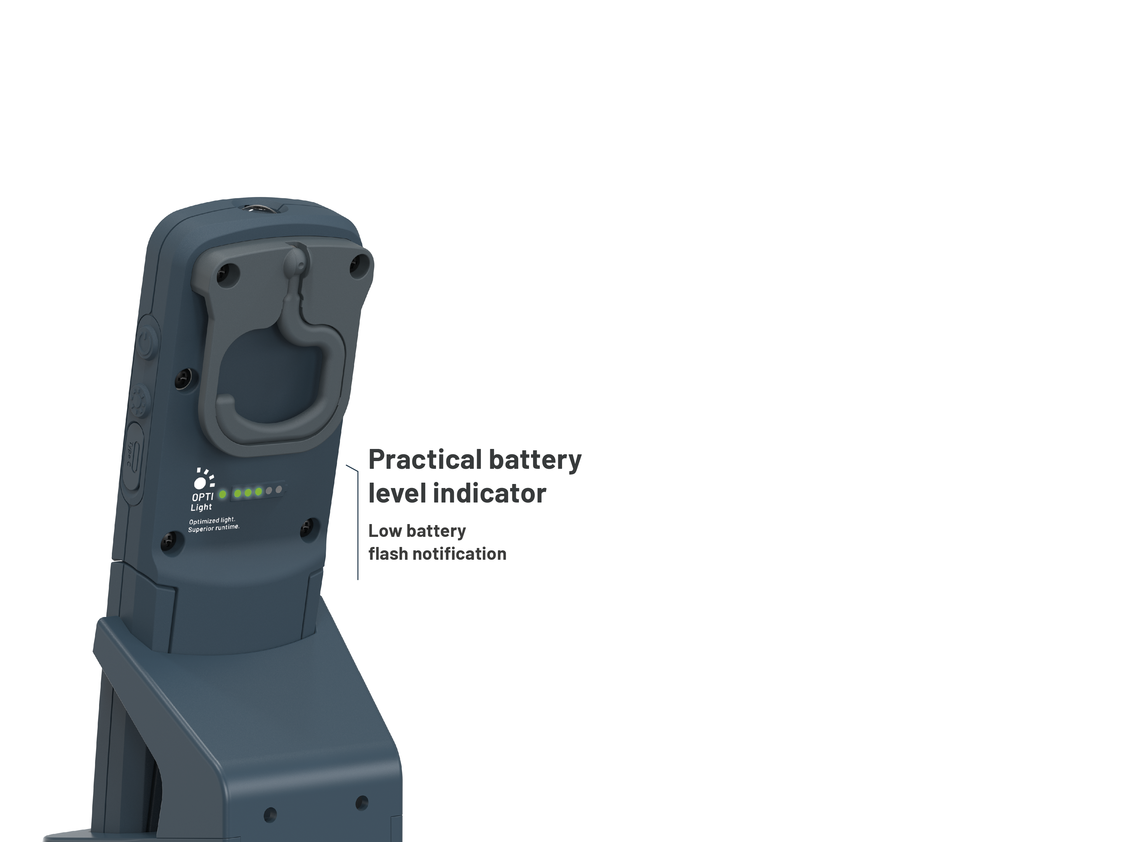
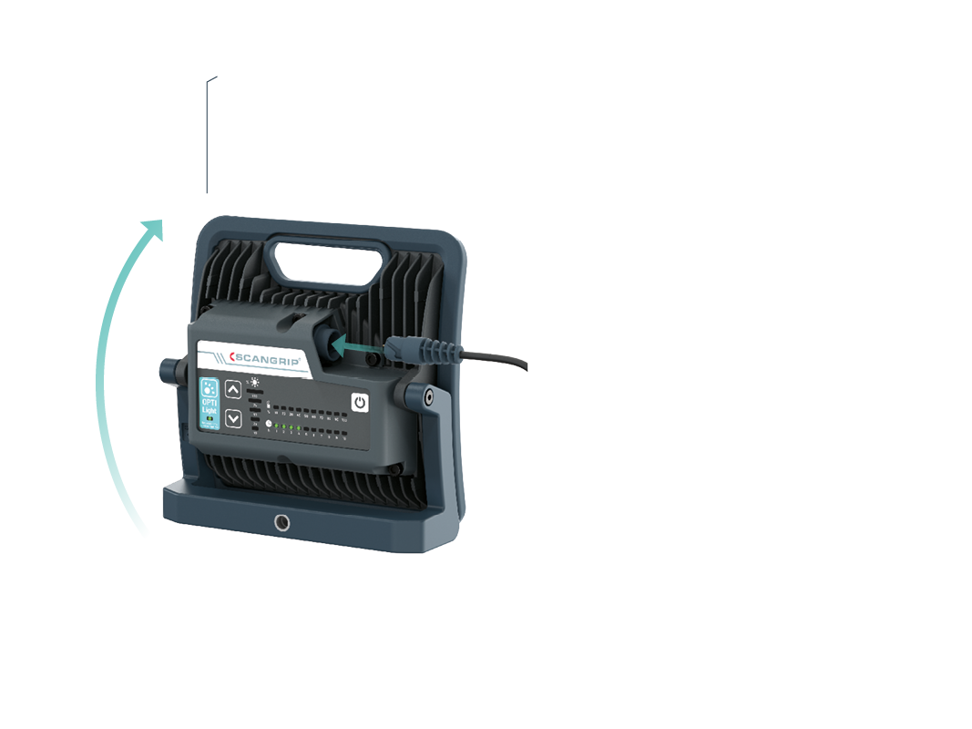
Product features
The new work lights have undergone a complete transformation when
it comes to visual design and come with a range of enhanced features
that provide numerous benefits to the end-user.
Integrated handle with durable rubber handle trim
More convenient connecting/ disconnecting of cable
Easier handling and use of bracket
Dedicated buttons for on/off and brightness control
Incl USB-C charging cable
Input charging socket with flexible protecting cover

Slide 16
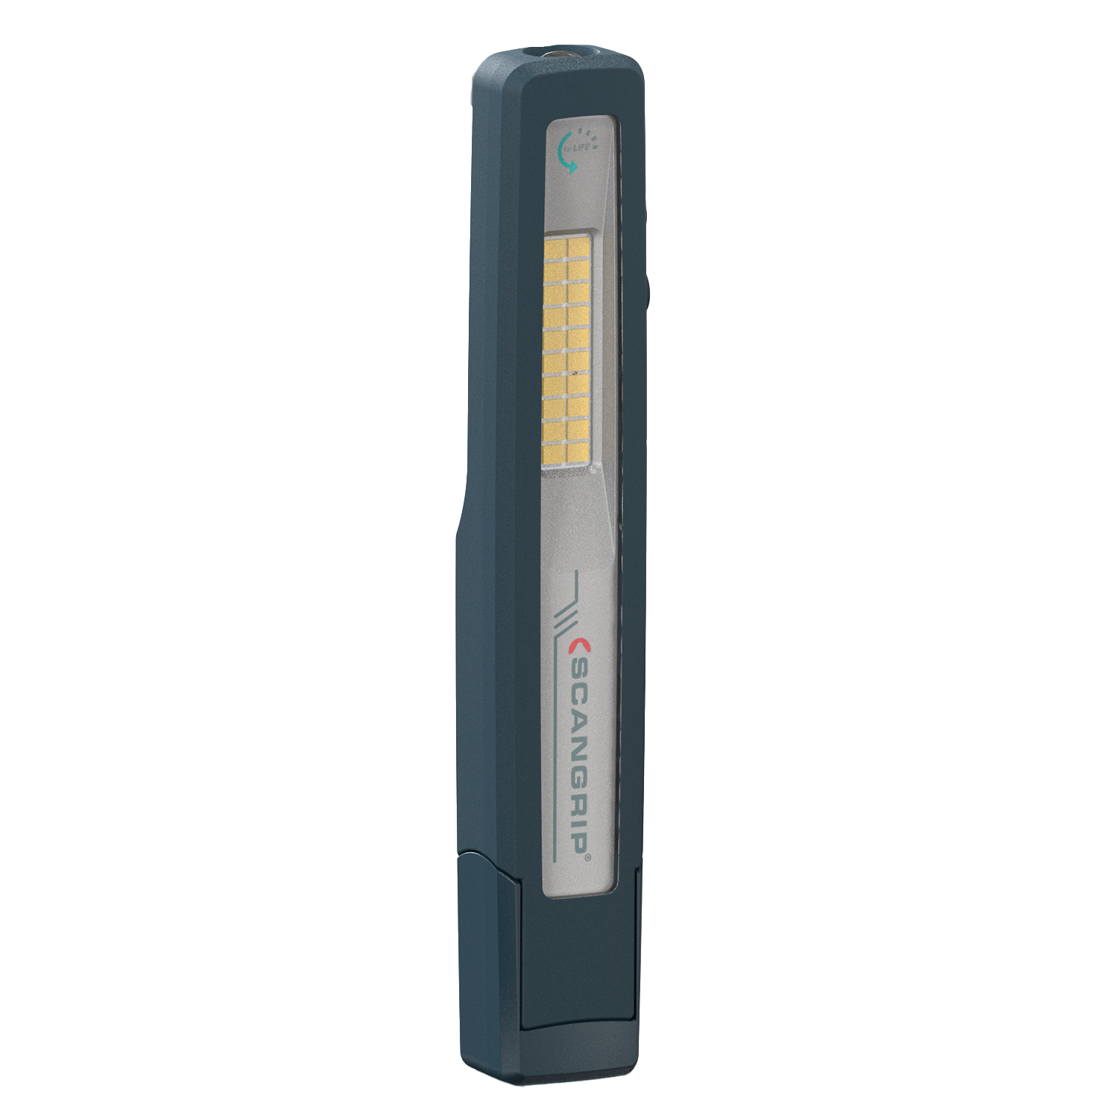
UNIPEN
Present version
New version
03.5420 UNIPEN
03.6209 UNIPEN
Handy 2-in-1 LED penlight
15-150 lm
Spot 75 lm
20 LEDs
IP65
OPTILight functionality
Pocket clip
Incl USB-C charging cable
€45.90

Slide 17
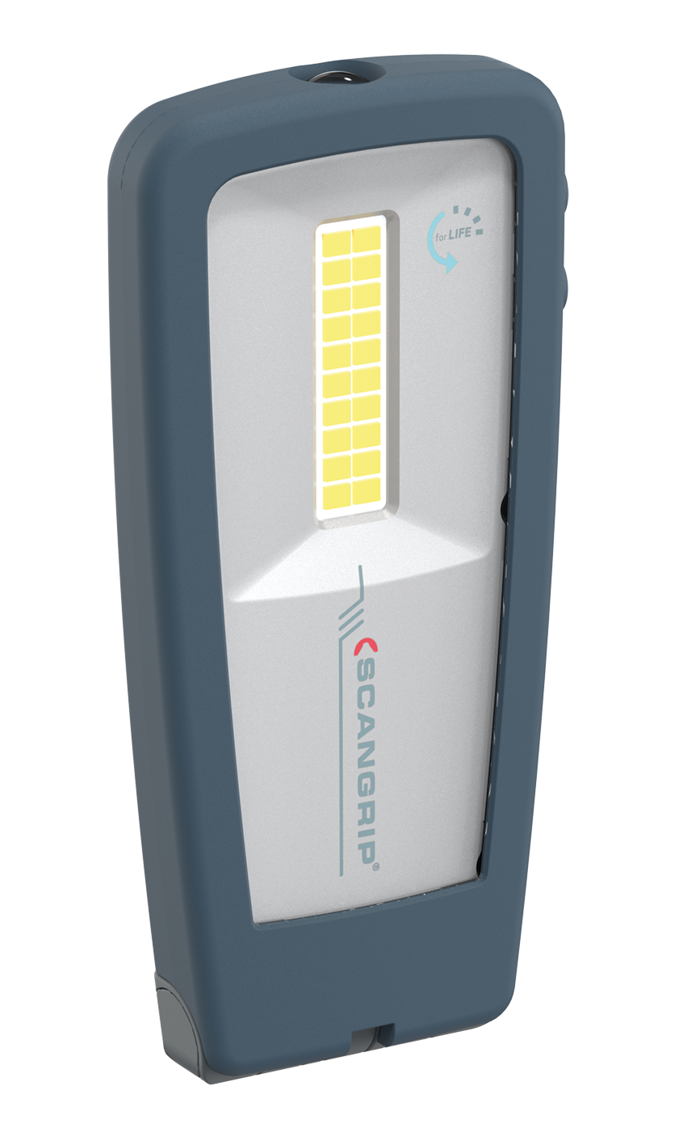
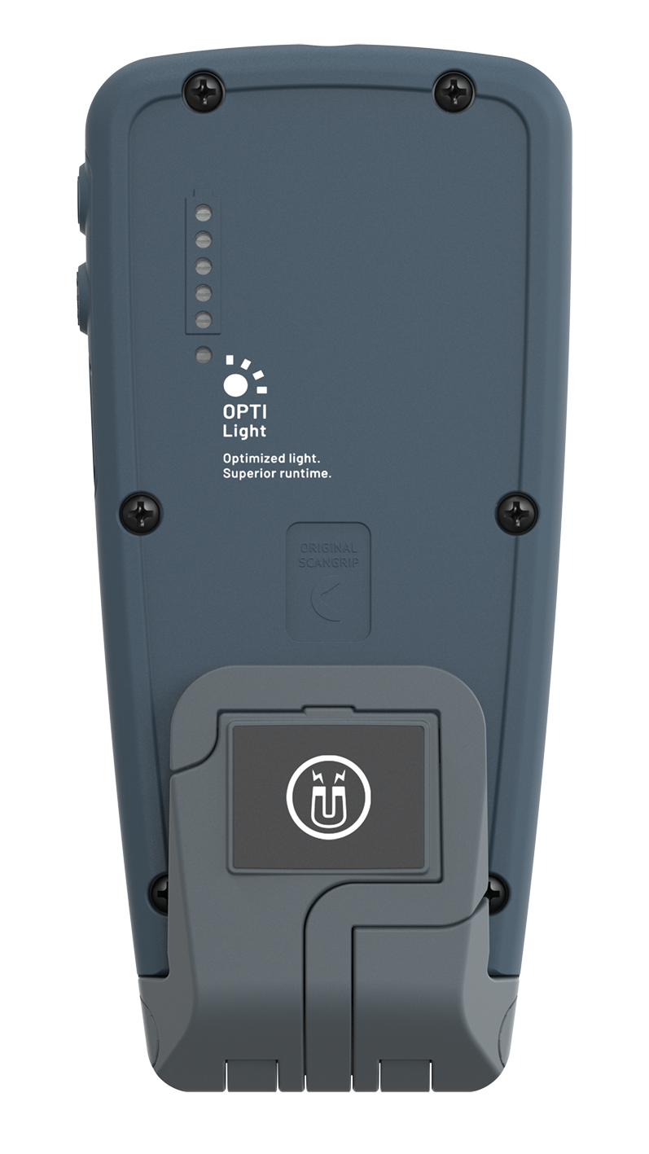
MINIFORM
Present version
New version
03.5404 MINIFORM
03.6207 MINIFORM
Ultra-slim LED handlamp
50-500 lm
Spot 175 lm
32 LEDs
IP65
Battery level indicator
OPTILight functionality
Flexible 180°lamp head
New, redesigned hook
Incl USB-C charging cable
€56.90

Slide 18
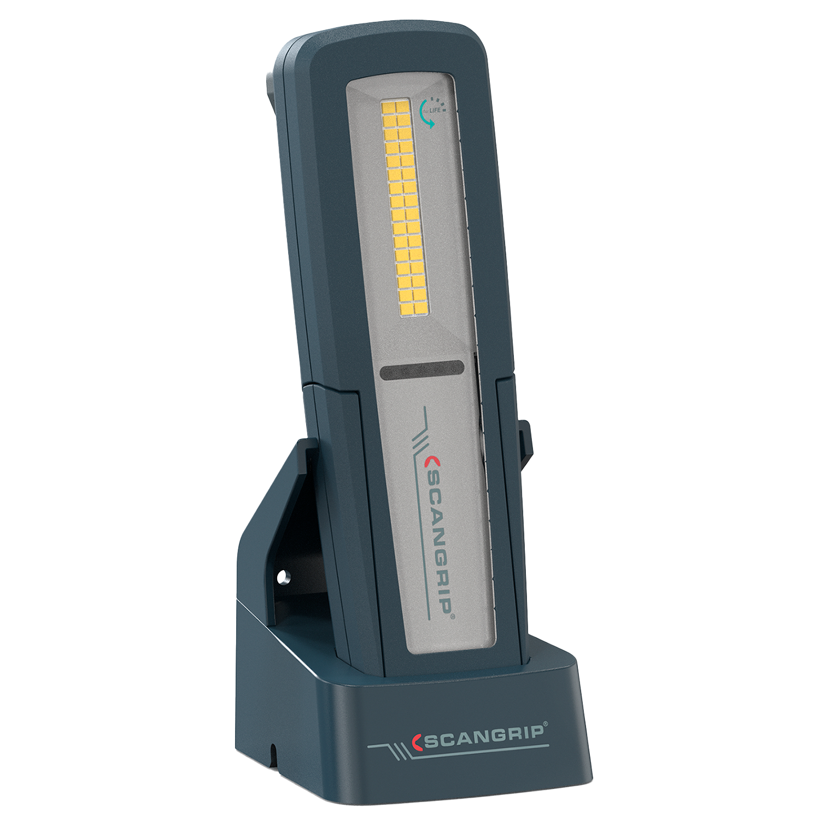
UNIFORM
Present version
New version
03.5407 UNIFORM
03.6208 UNIFORM
Multifunctional LED handlamp in base
50-500 lm
Spot 175 lm
32 LEDs
IP65
OPTILight functionality
Battery level indicator
Low battery flash notification
Incl USB-C charging cable
€89.90

Slide 19
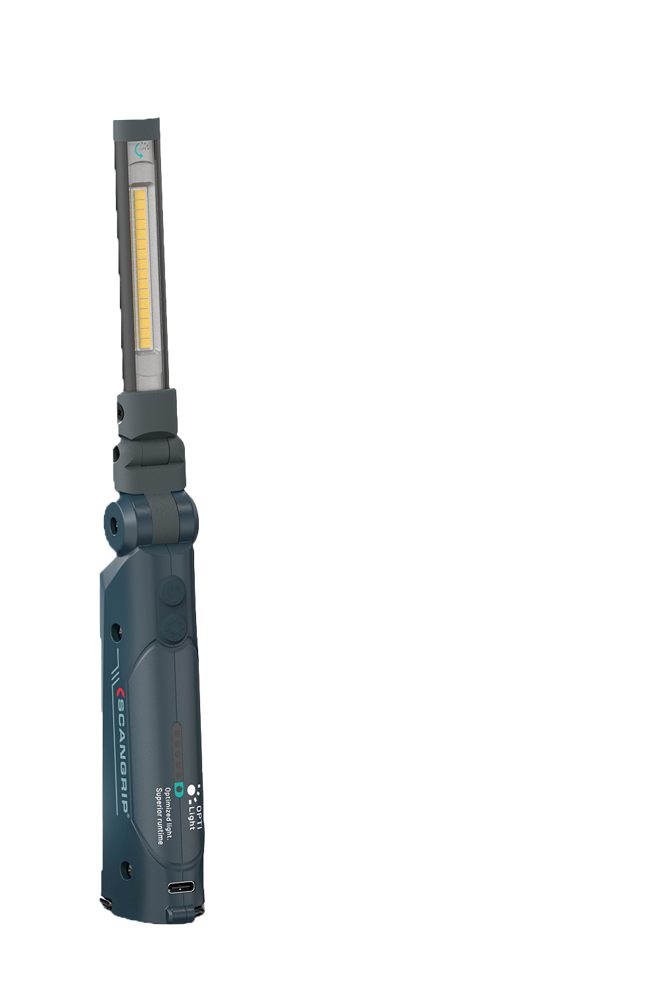
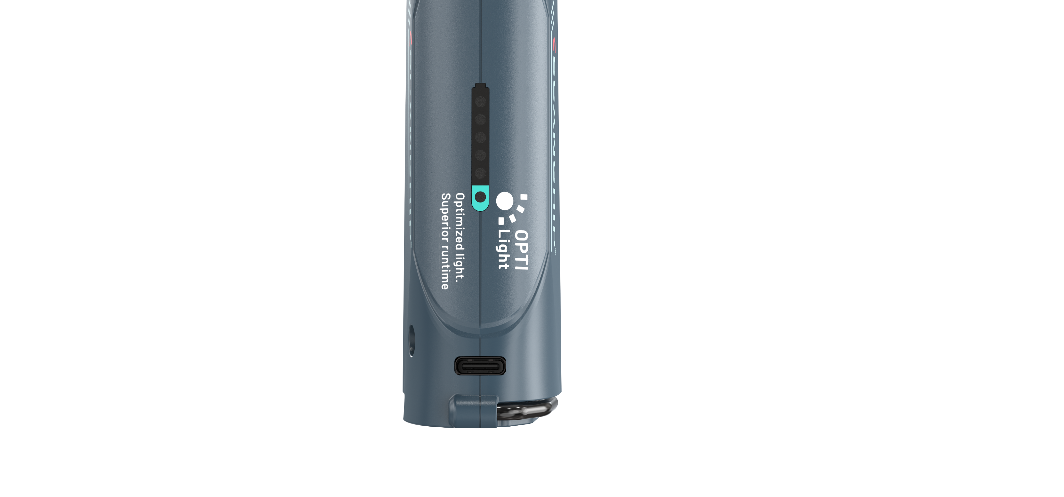
MINI SLIM
Present version
New version
03.5610 MINI SLIM
03.6210 MINI SLIM
Inspection light, work light and flashlight in one lamp
20-200 lm
Spot 100 lm
16 LEDs
IP30
OPTILight functionality
Compact and portable
Incl USB-C charging cable
€62.90

Slide 20
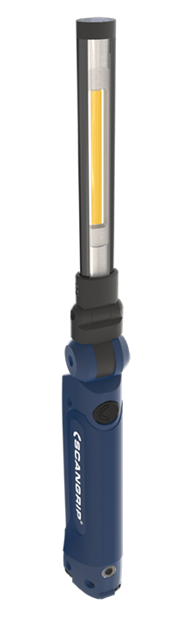
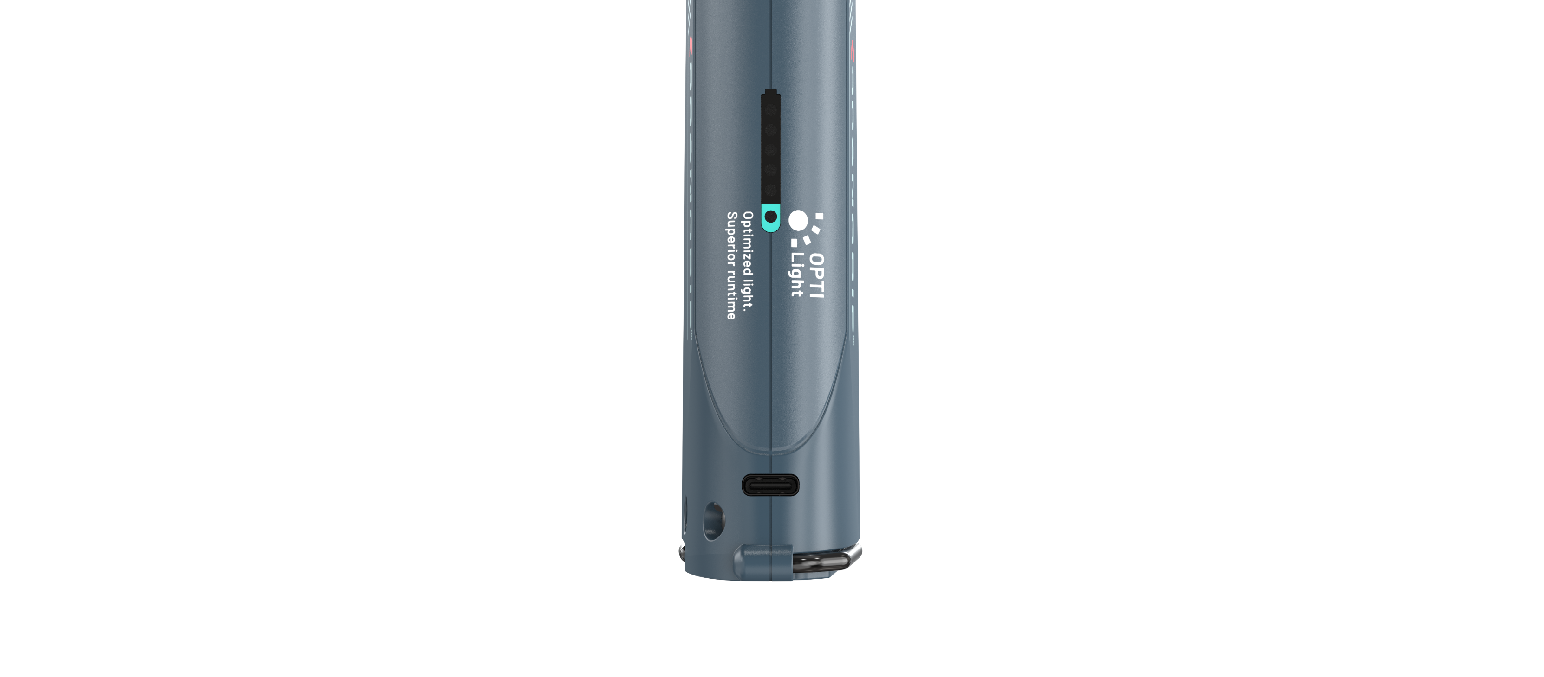
SLIM
Present version
New version
03.5612 SLIM
03.6211 SLIM
Inspection light, work light and flashlight in one lamp
50-500 lm
Spot 100 lm
20 LEDs
IP30
OPTILight functionality
Compact and portable
Incl USB-C charging cable
€77.90

Slide 21
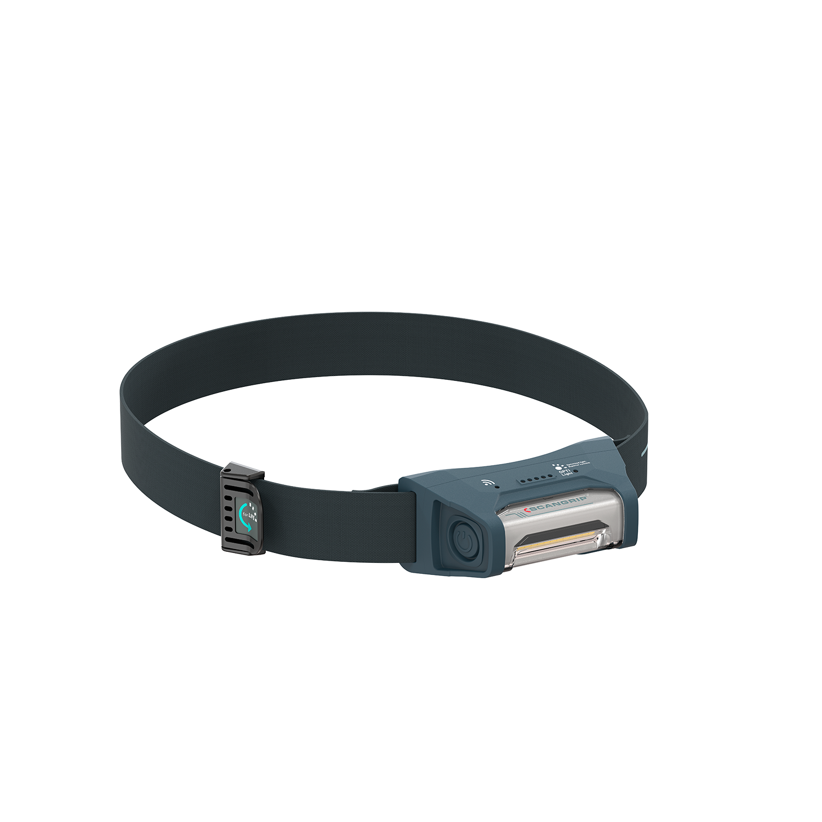
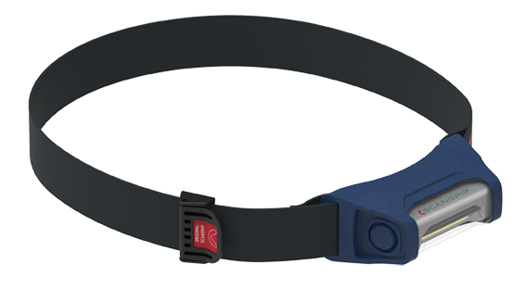
I-VIEW
New version
03.6212 I-VIEW
LED headlamp with on/off sensor
40-400 lm
12 LEDs
IP65
OPTILight functionality
Ergonomic design
Lightweight
Incl USB-C charging cable
€71.90
Present version
03.5626 I-VIEW

Slide 22
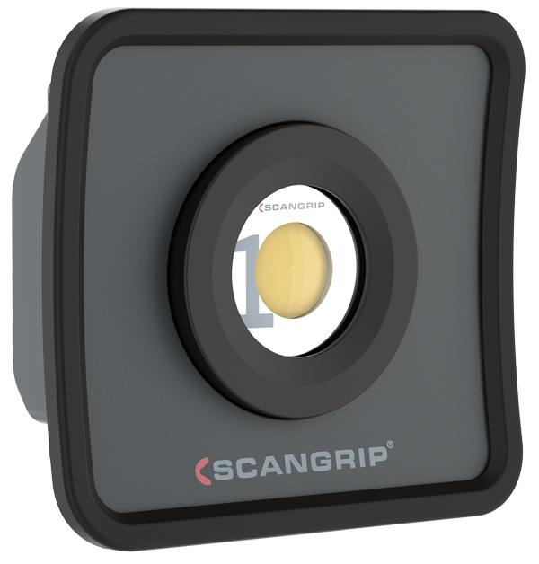
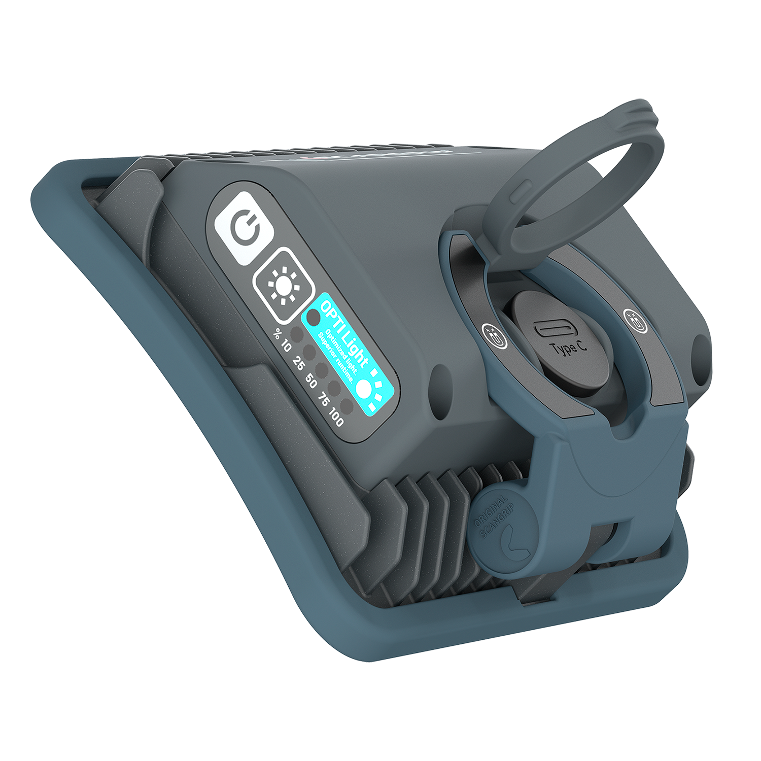
NOVA MINI
Present version
New version
03.6010 NOVA MINI
03.6200 NOVA MINI
Compact LED floodlight
100-1000 lm
26 LEDs
IP65
Incl USB-C charging cable
€74.90
SMART GRIP 4-in-1 system for a comfortable, firm hand grip and flexible positioning
OPTILight functionality

Slide 23
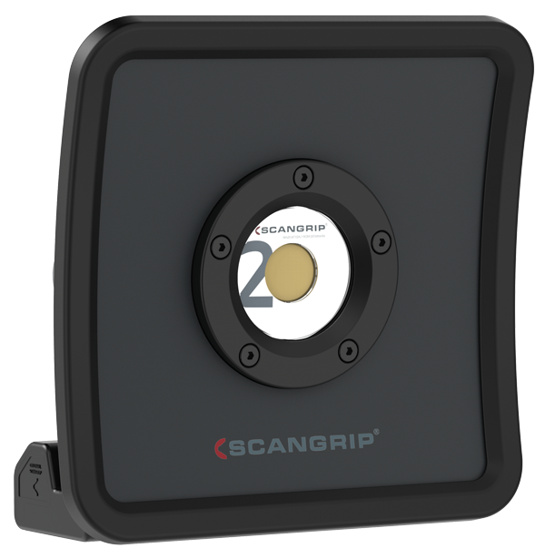
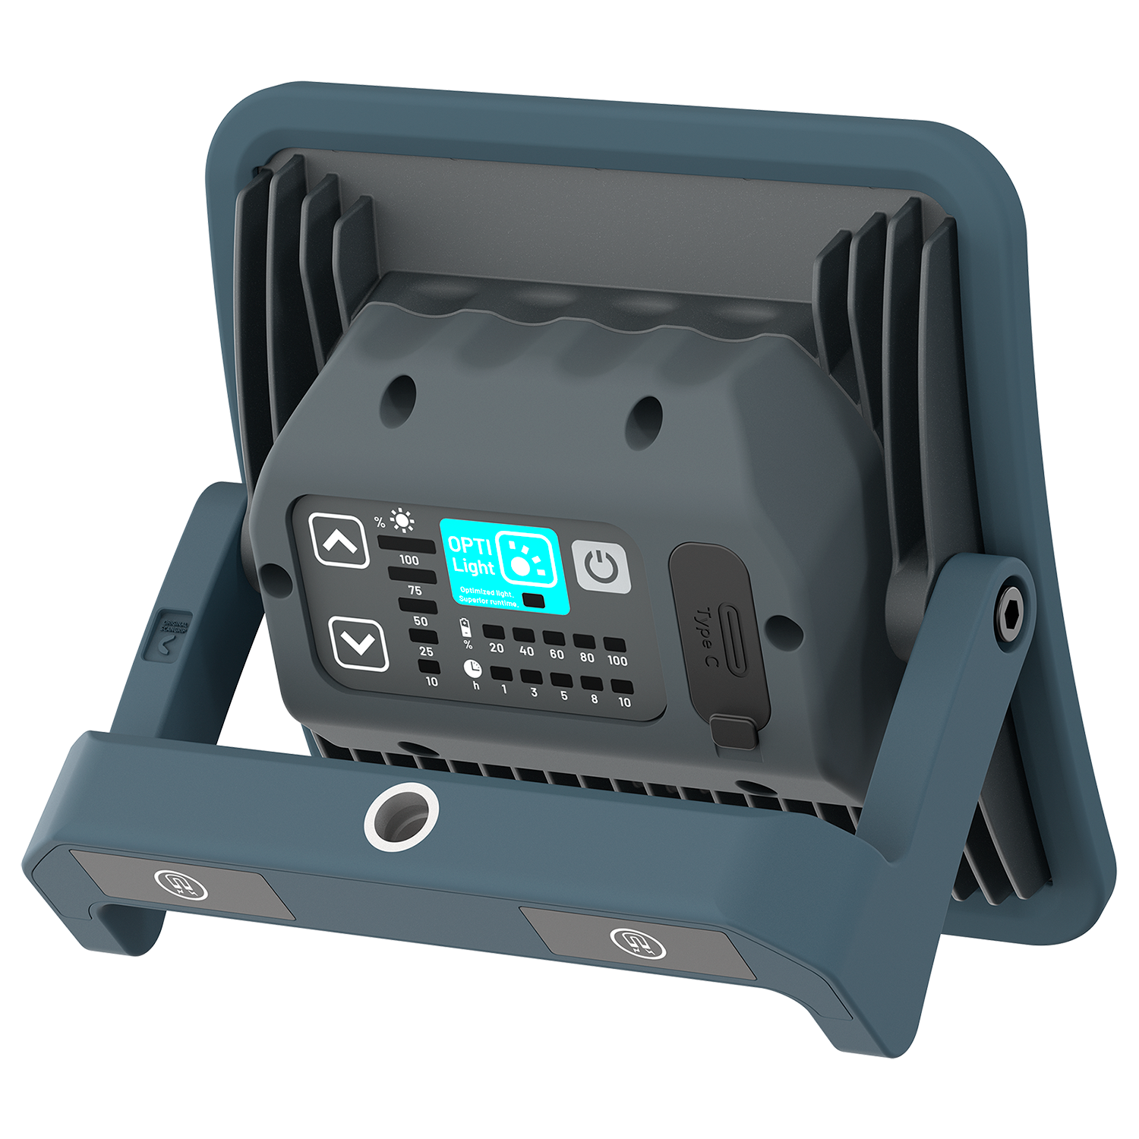
NOVA R
Present version
New version
03.5456 NOVA R
03.6201 NOVA R
Universal LED work light
200-2000 lm
44 LEDs
IP67
OPTILight functionality
Light dimmer function
Incl USB-C charging cable
€104.90
OPTILight functionality
Ergonomic and compact design

Slide 24
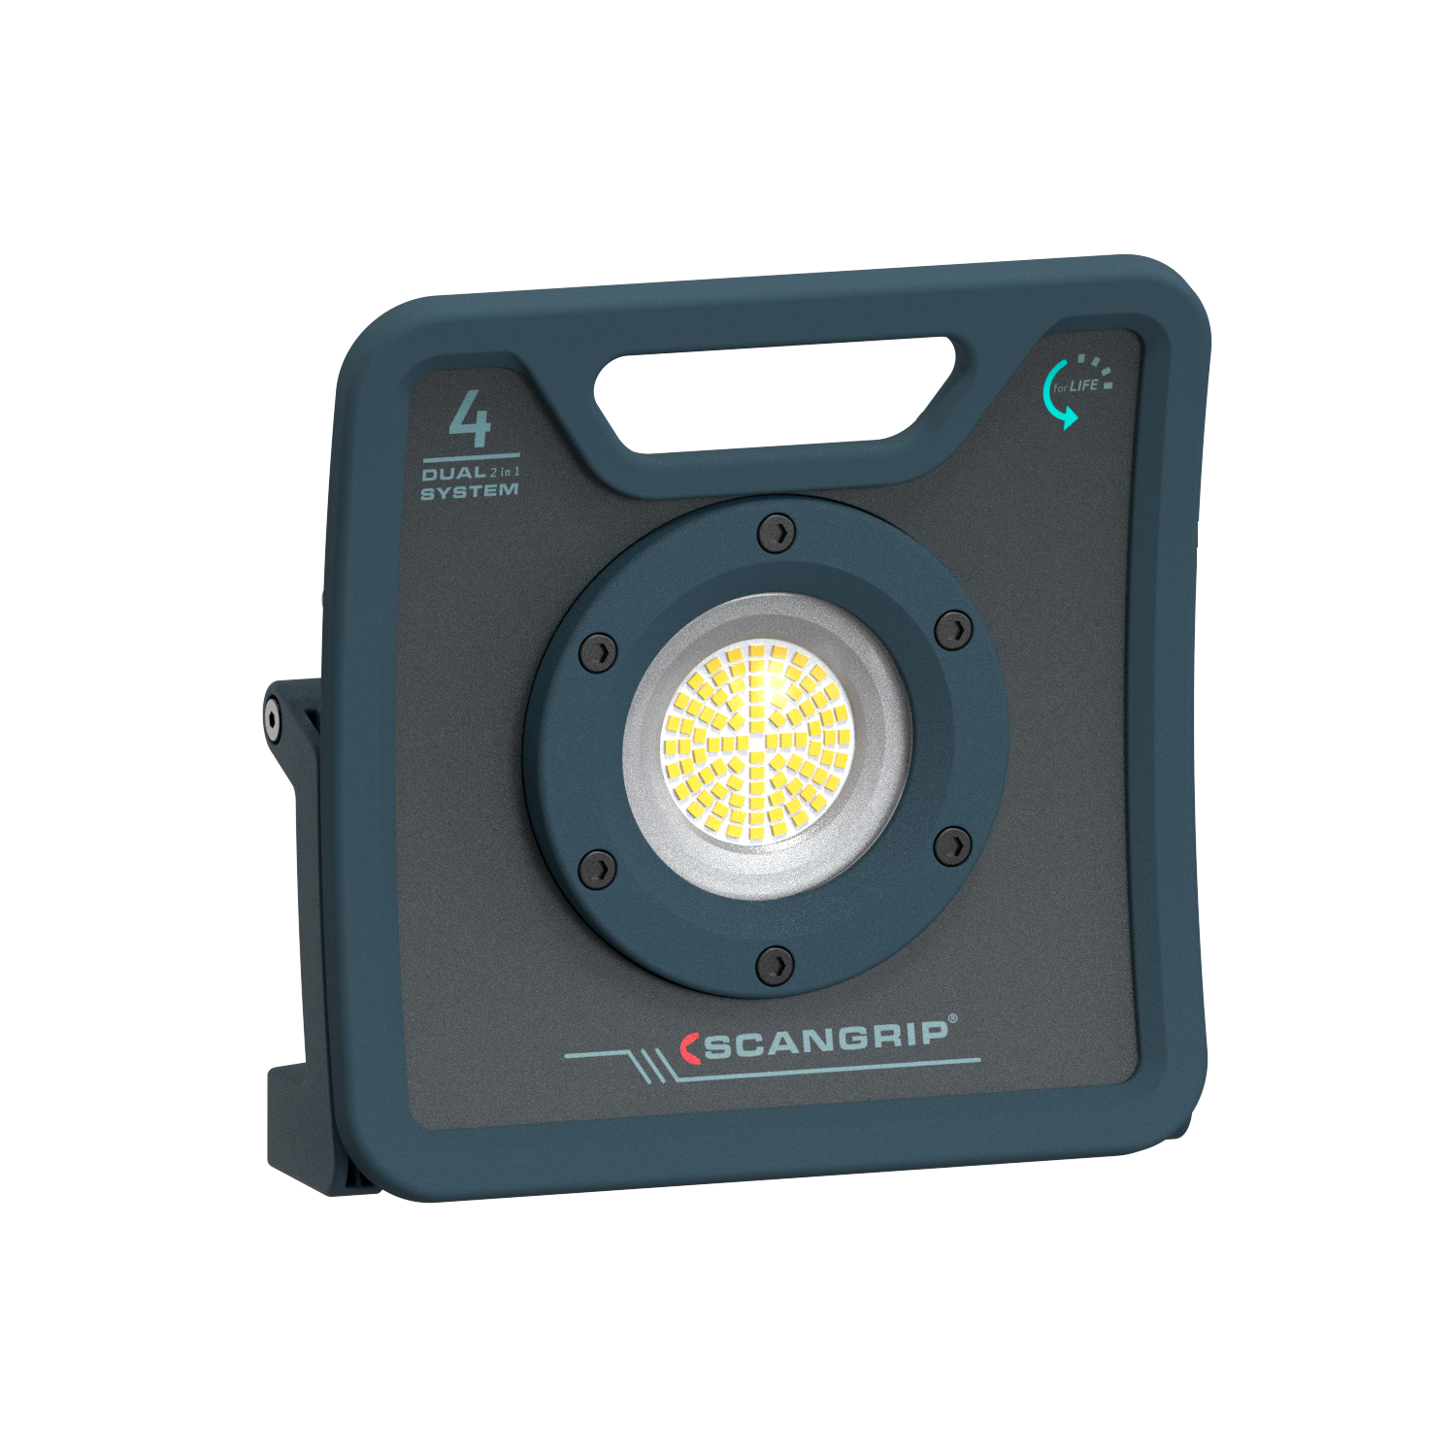
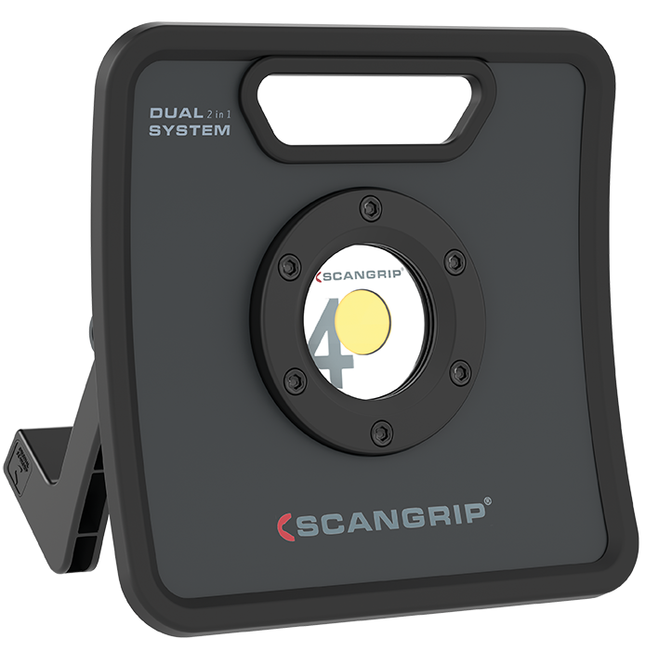
FLOODLIGHTS WITH DUAL SYSTEM
Present version
New version
03.5441 NOVA 4K C+R
03.6204 NOVA 4 C+R
Rechargeable and with cable
400-4000 lm
90 LEDs
Light dimmer function
IP67
€209.90
OPTILight functionality
More convenient connecting/ disconnecting of cable
Easier handling and use of bracket Integrated carrying handle

Slide 25
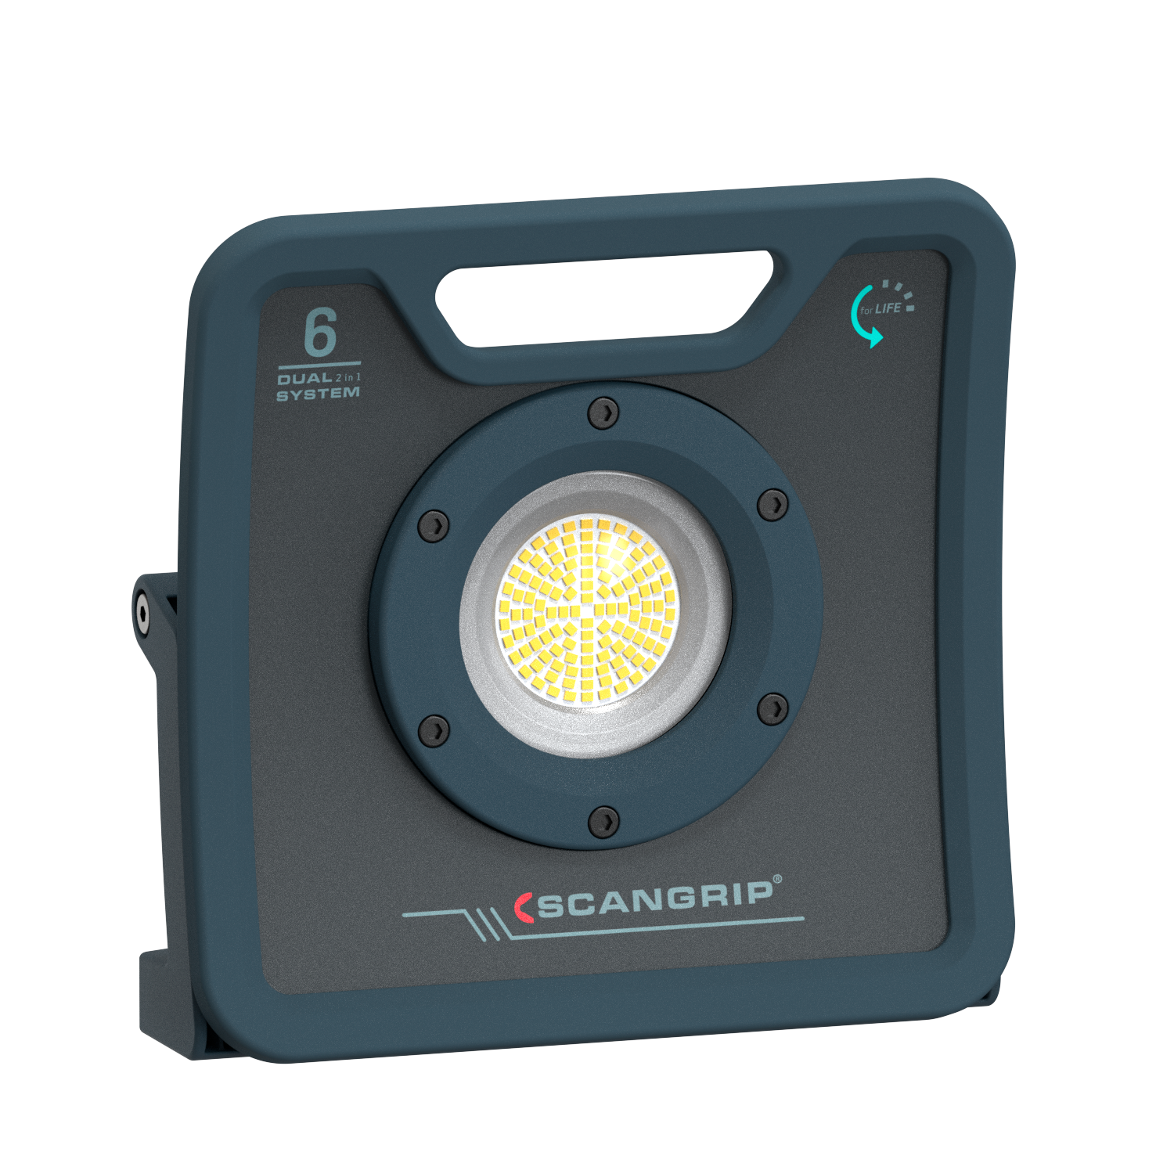
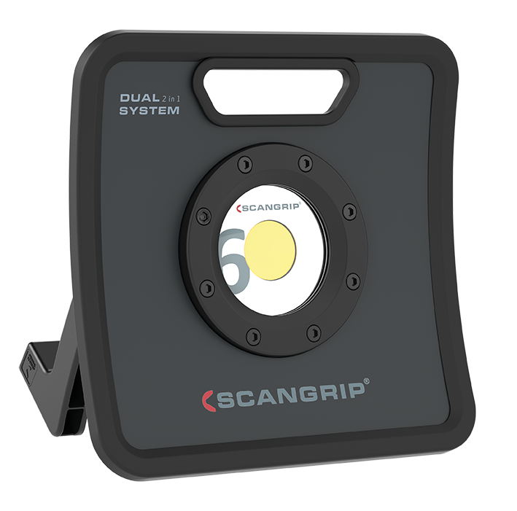
FLOODLIGHTS WITH DUAL SYSTEM
Present version
New version
03.5443 NOVA 6K C+R
03.6205 NOVA 6 C+R
Rechargeable and with cable
600-6000 lm
120 LEDs
Light dimmer function
IP67
€249.90
OPTILight functionality
More convenient connecting/ disconnecting of cable
Easier handling and use of bracket Integrated carrying handle

Slide 26
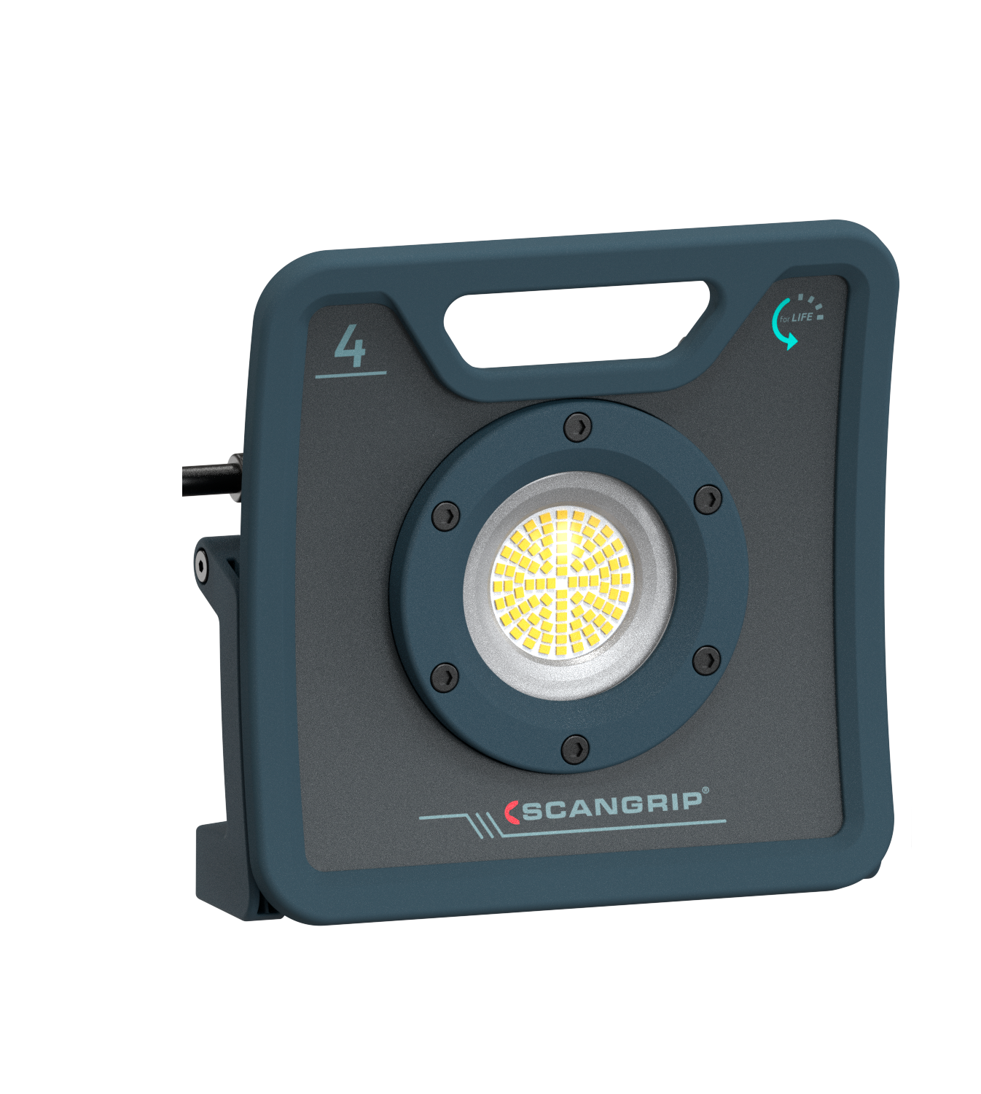
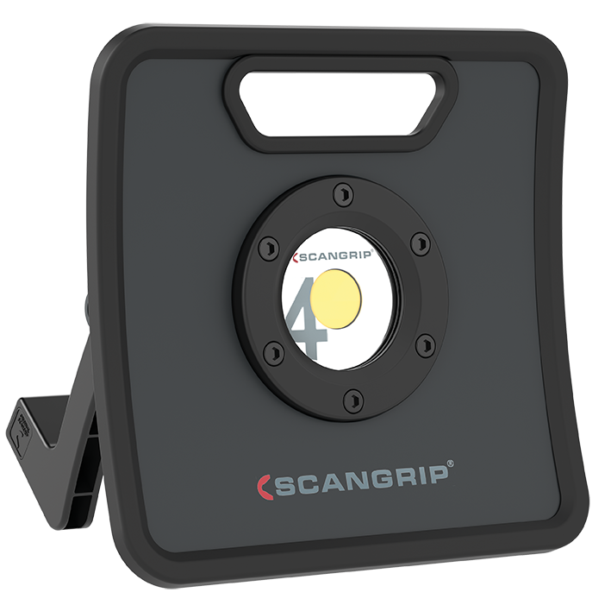
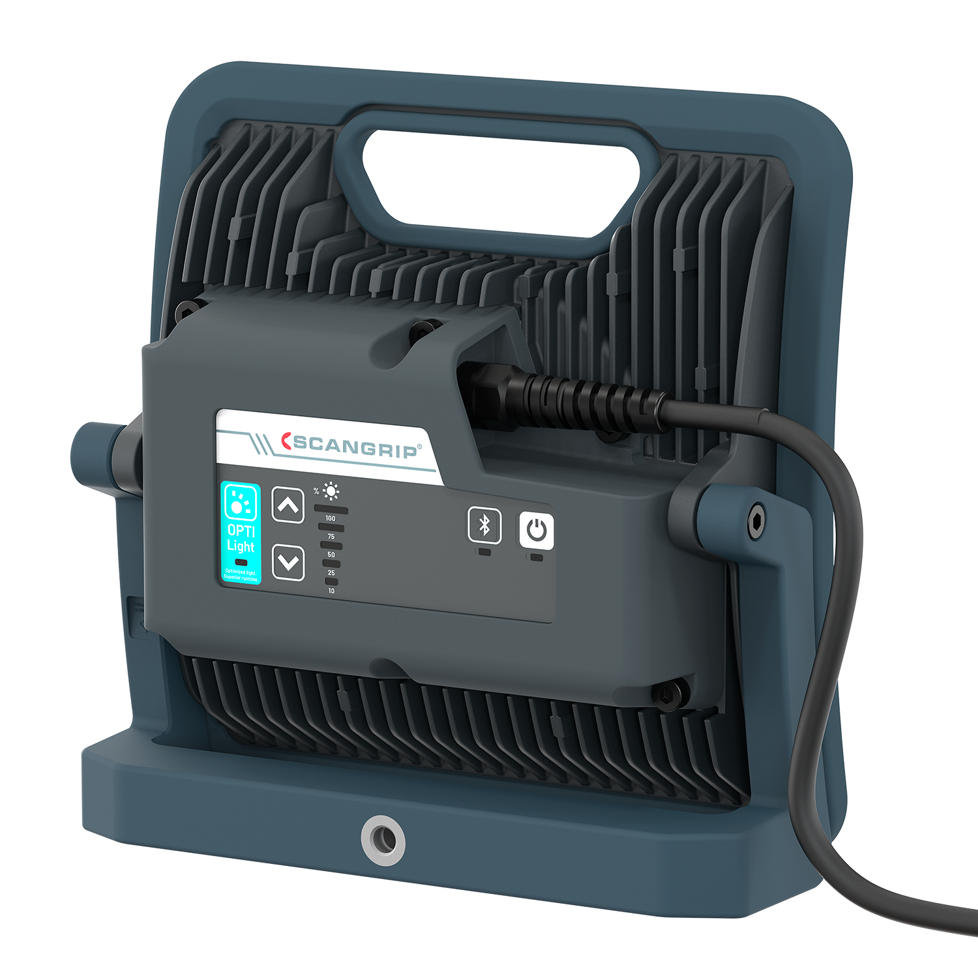
CABLED FLOODLIGHTS
Present version
New version
03.5440 NOVA 4K
03.6202 NOVA 4
400-4000 lm
90 LEDs
IP67
€134.90
OPTILight functionality
Light dimmer function
Integrated carrying handle

Slide 27
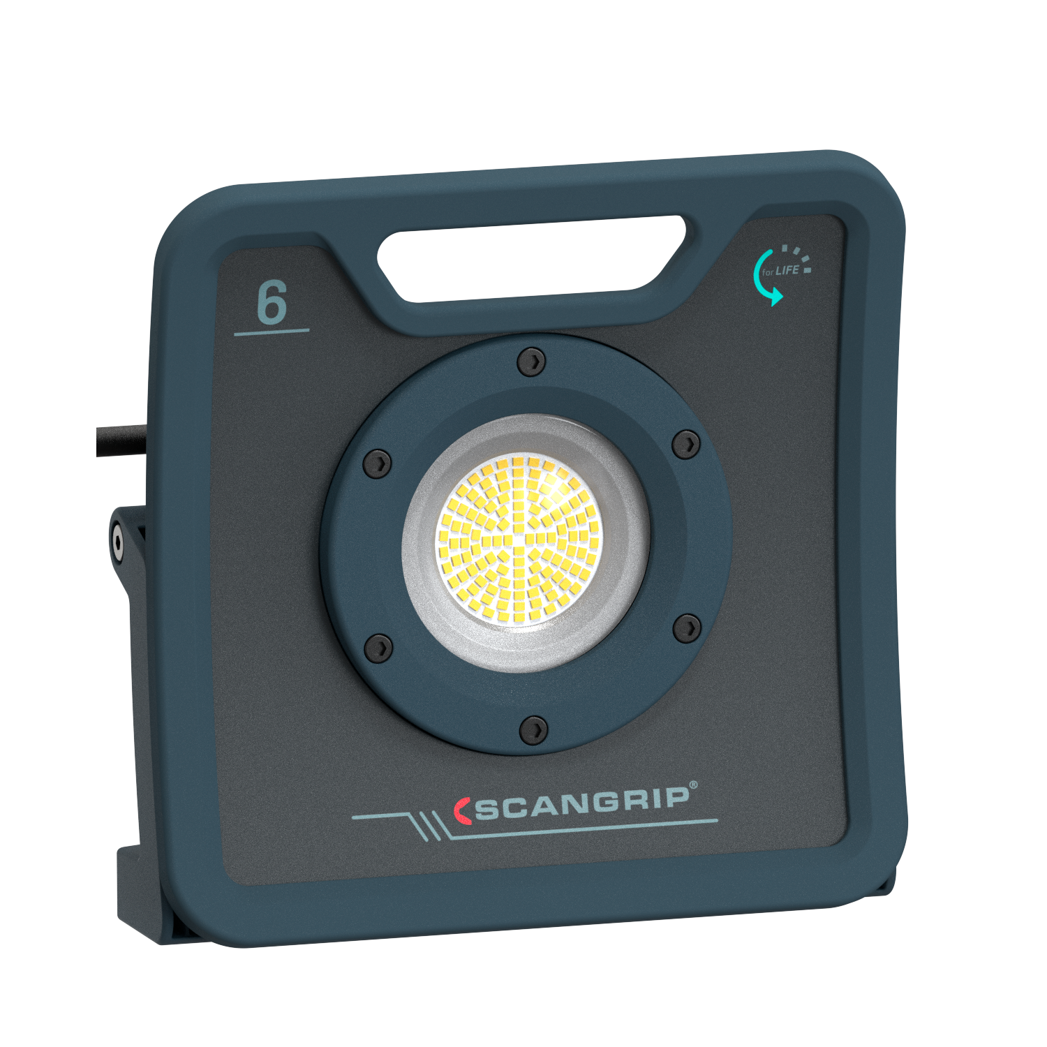
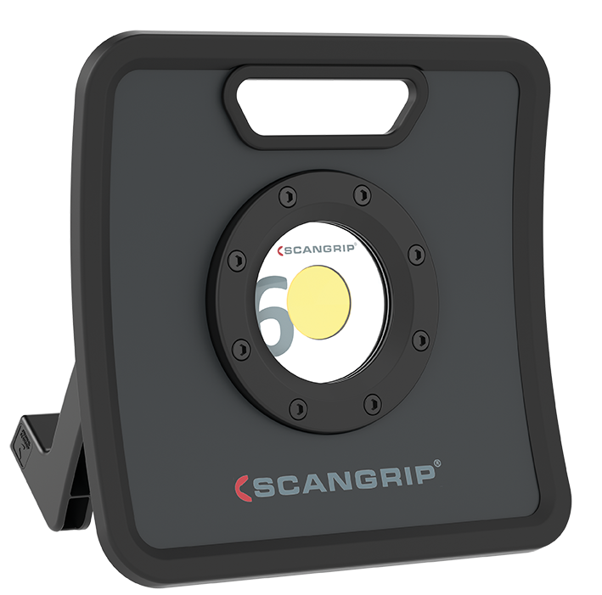
CABLED FLOODLIGHTS
Present version
New version
03.5442 NOVA 6K
03.6203 NOVA 6
600-6000 lm
120 LEDs
IP67
€154.90
OPTILight functionality
Light dimmer function
Integrated carrying handle

Slide 28
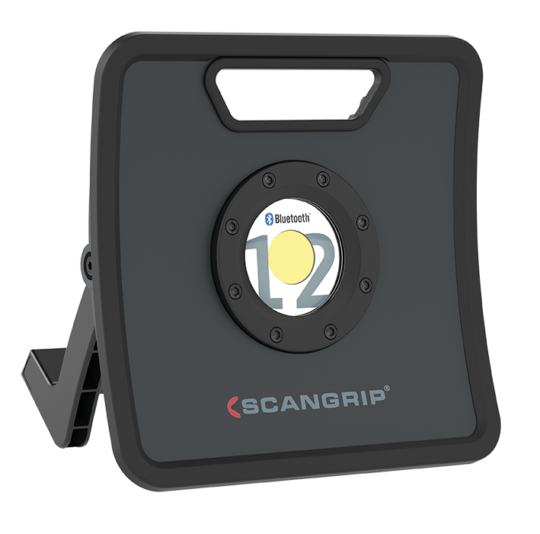
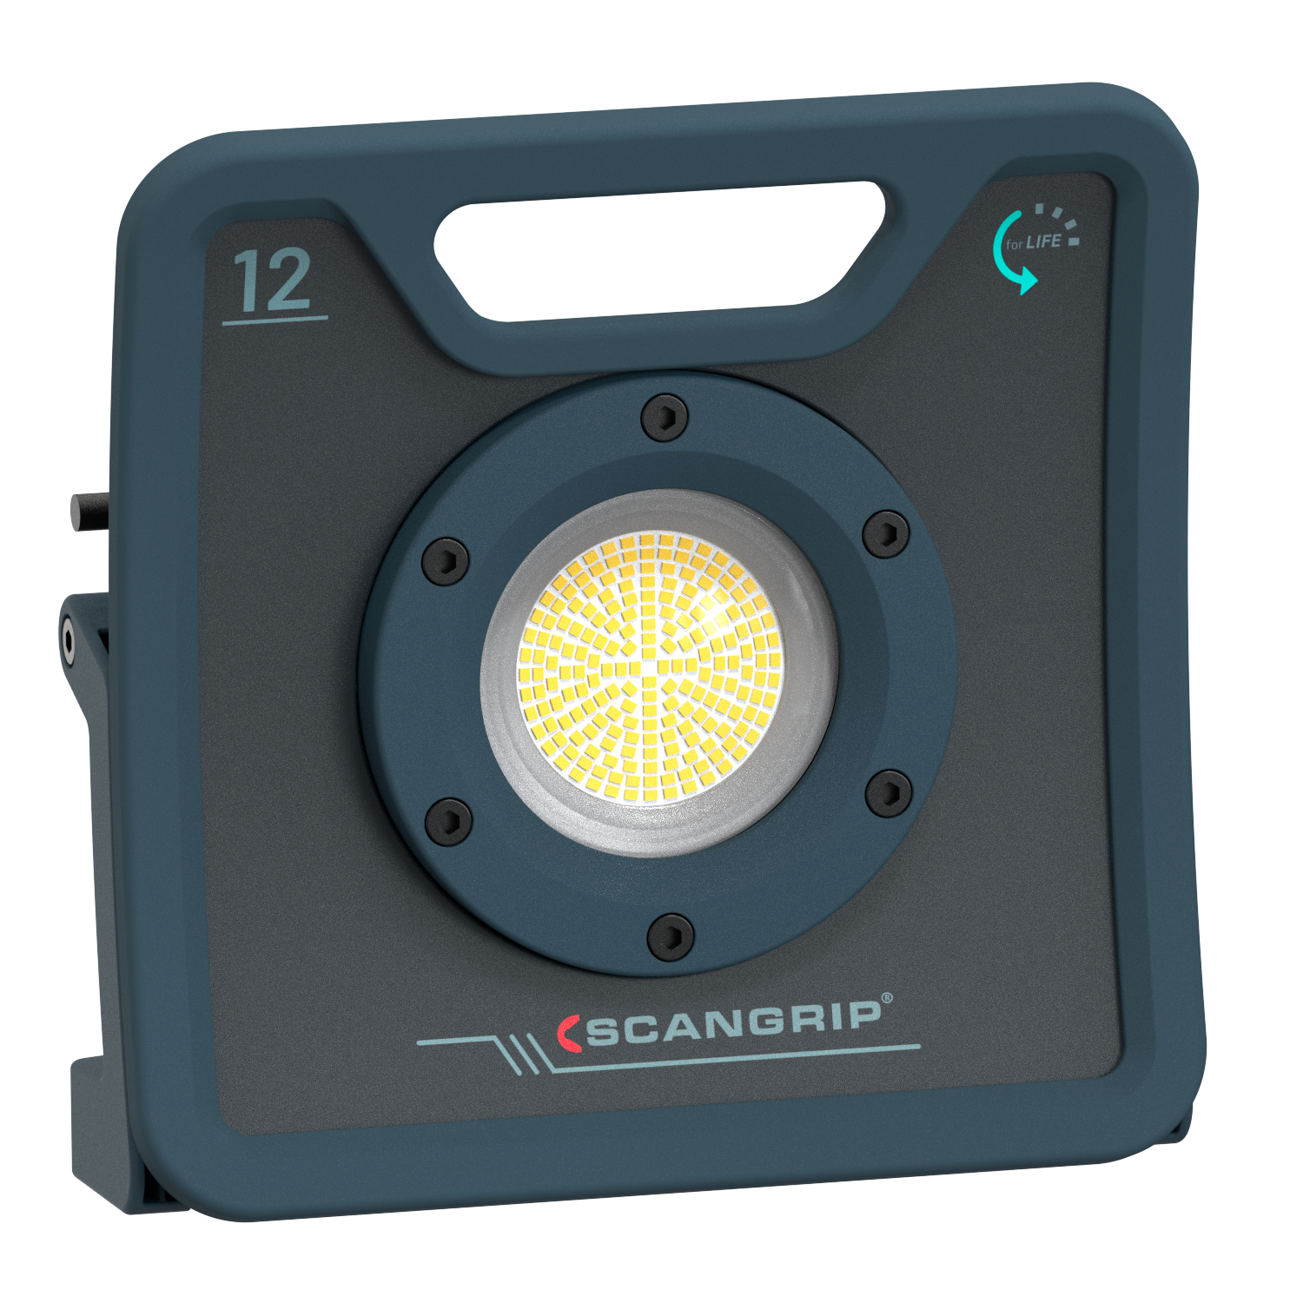
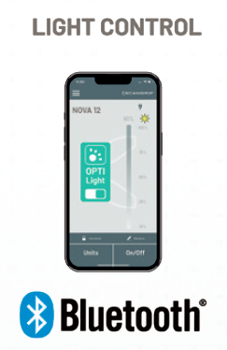
CABLED FLOODLIGHTS
Present version
New version
03.5444 NOVA 12K
03.6206 NOVA 12
1200-12000 lm
200 LEDs
IP67
BLUETOOTH light control
€279.90
OPTILight functionality
Light dimmer function
Integrated carrying handle

Slide 29
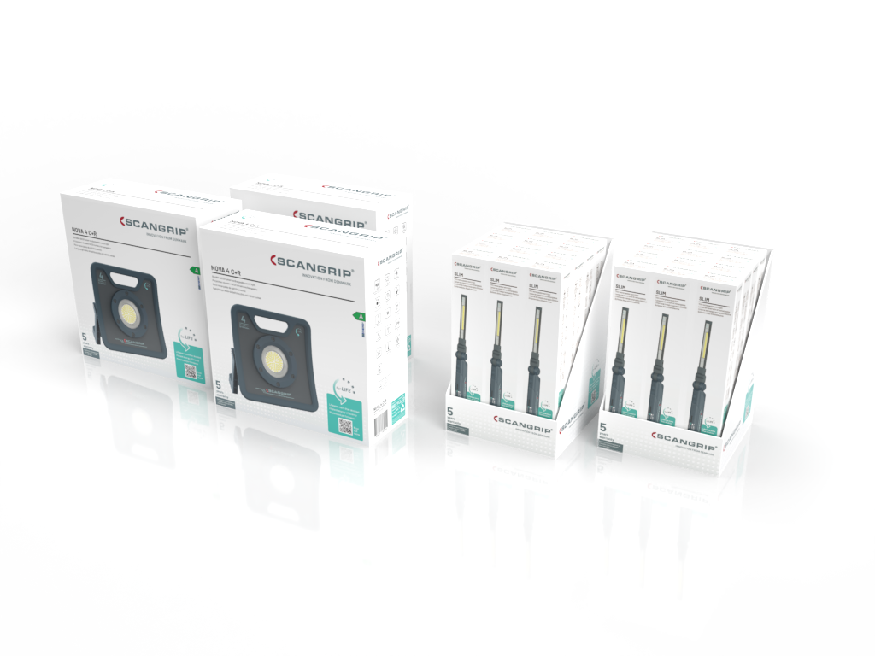
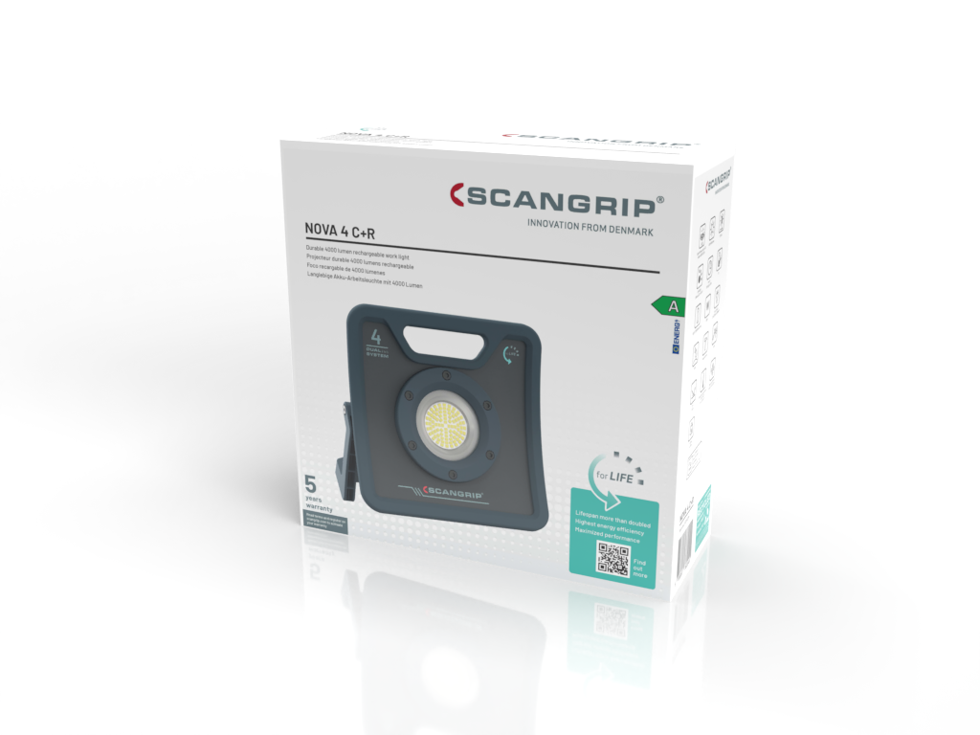
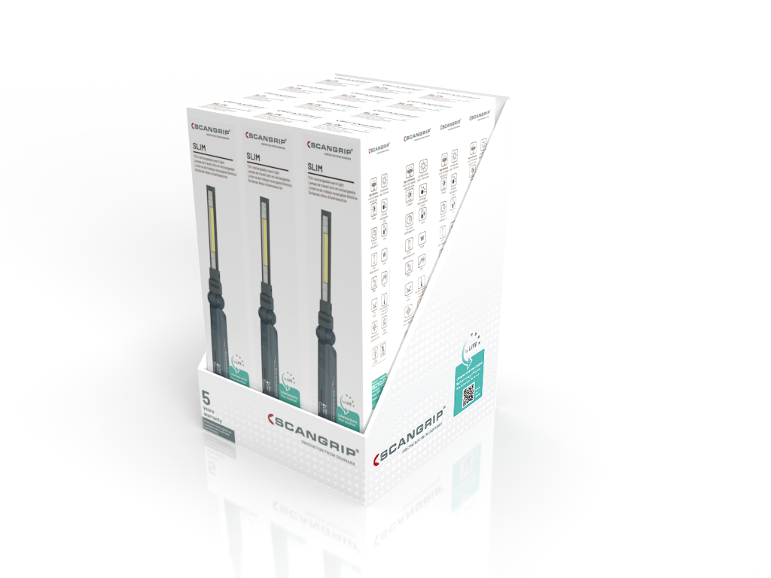
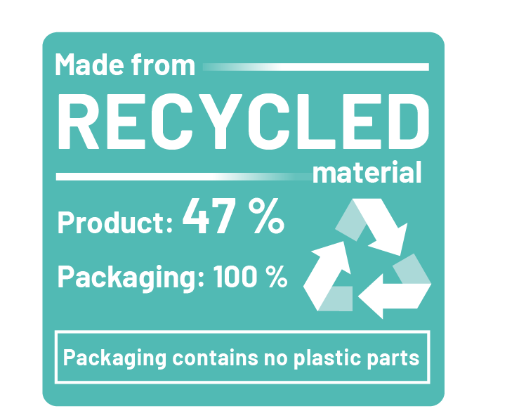
Packaging design
The packaging is made from 100% recycled materials and completely free of any plastic parts

Slide 30
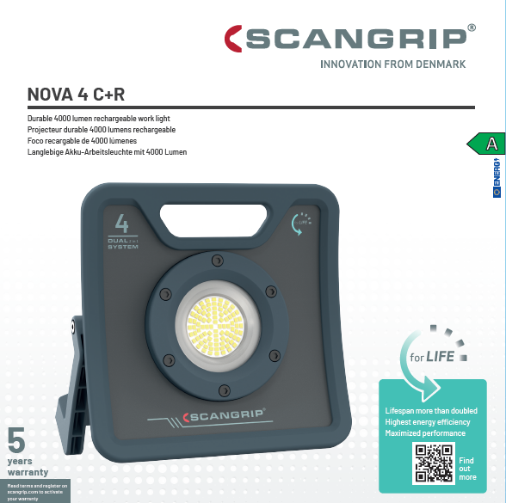
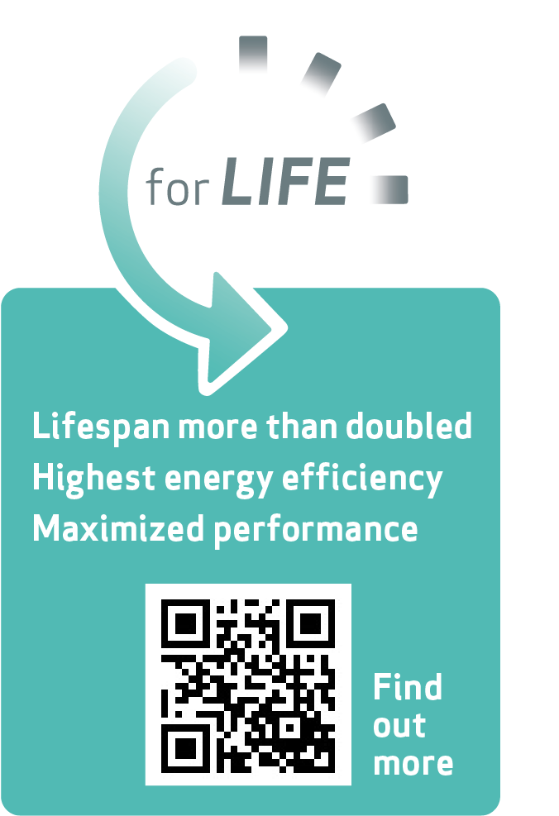
Packaging design - front

Slide 31
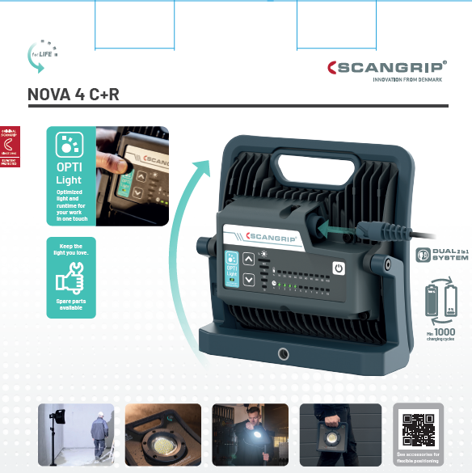
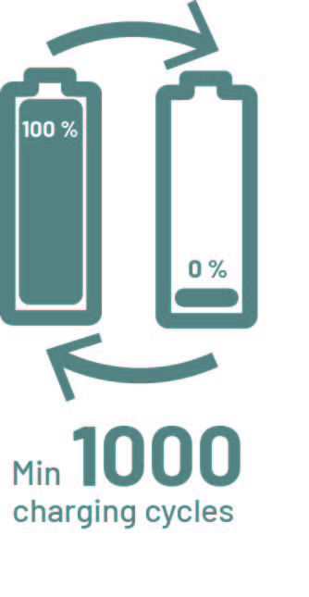
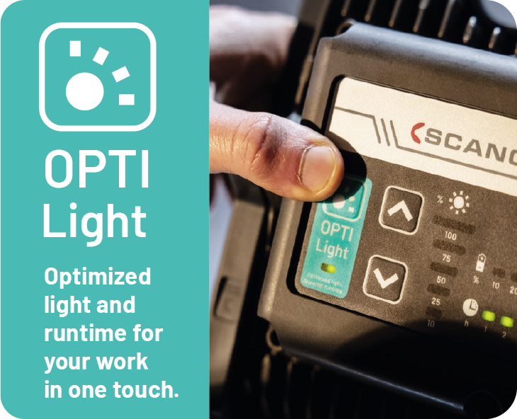
Packaging design – key messages

Slide 32
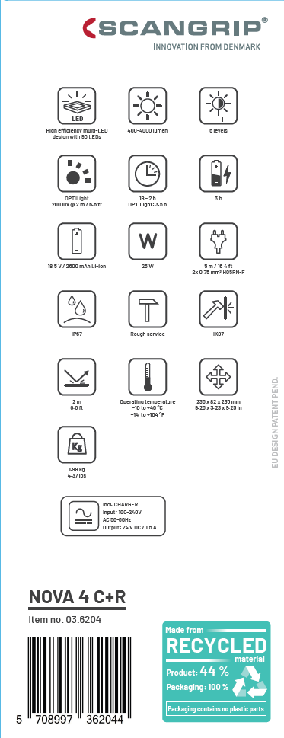
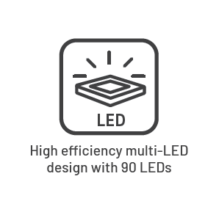
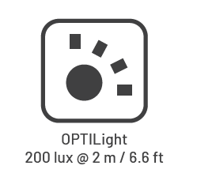
Packaging design

Slide 33
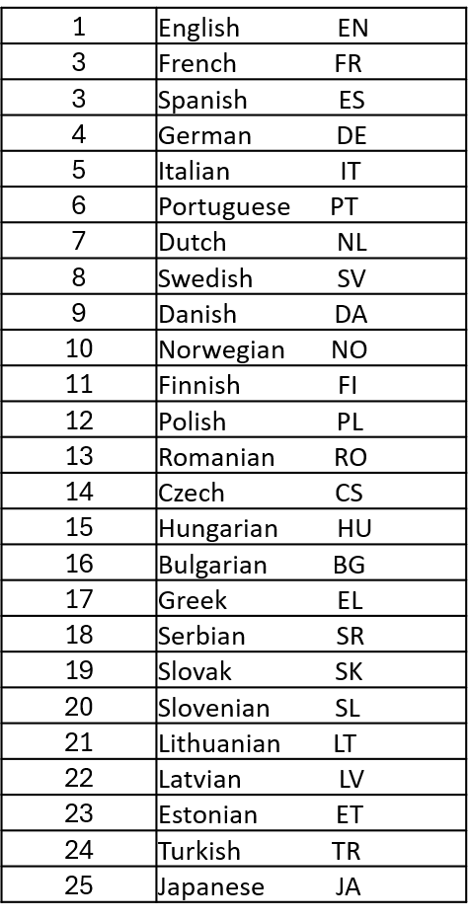
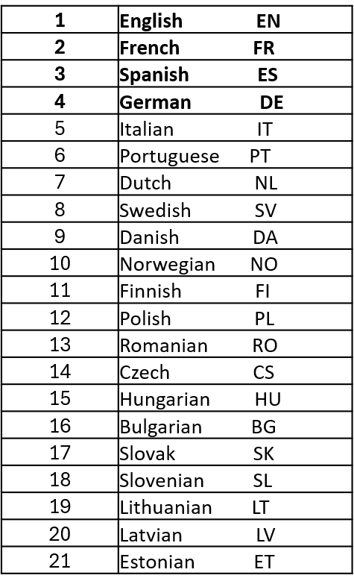
More languages on packaging and in manuals
Languages in manuals
Streamlined according to ISO standard for country codes
Expected to be implemented for all SCANGRIP products Q1 2025
Languages on packaging
Main languages on front, equal size

Slide 34
PARTNERSITE: FOR LIFE symbols

Slide 35
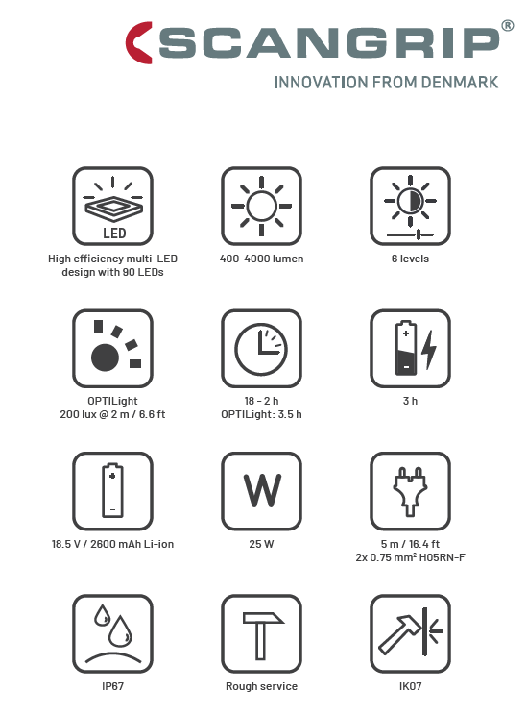
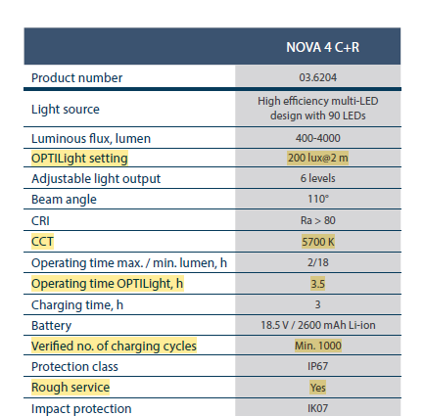
ROUGH SERVICE
Applies for all FOR LIFE products (except SLIM, MINI SLIM)
Classify the product to be DURABLE and LONG LIFE:
Withstands severe mechanical handling
Resistant to vibrations and other external stresses that can damage the lamp, proved by:
- VIBRATION TESTING
- IMPACT TESTING
- DROP TESTING
INGRESS PROTECTION (IP) minimum IP54
SUPPLY CORD (if applicable) – H07RN-F
STANDARD EN IEC 60598-1

Slide 36
Product sheets
English
French
German
Danish
Product
description
Comparison
new and old
Specifications
as presented in pricelist/brochure
FOR LIFE general description

Slide 37
FOR LIFE Literature
PRICELIST
H2 2024
New FOR LIFE products included
”Former” versions deleted
WORK LIGHT brochure 2024
New FOR LIFE products included
”Former” versions deleted
FOR LIFE
introduction brochure
Quick guide taking you briefly through the FOR LIFE concept and provides overview of improvements compared to former versions
English
German
French
Other languages on demand
English
German
French
Spanish
Portuguese
Italian
Danish
Swedish
Norwegian
Finnish
Polish
Czech
PDF mid August
Prints 1st September

Slide 38
Expand your business
The FOR LIFE products are the market's most sustainable work lights, meeting the demand for sustainability and creating new business opportunities.

Slide 39
Launch plan for 2024 lighting season
Introduction at the
INT. HARDWARE FAIR
in Cologne
Marketing material
available on Partnersite
Ready for shipment (Overlap of old / new versions)
March
May
August
September
Corporate branding video
+
FOR LIFE concept video
Masterdata
Product videos/ pictures
Complete content package, SOME, prints
Product sheets

Slide 40
Use it. Love it. Keep it.
We believe in empowering professionals to excel in their everyday tasks.
SCANGRIP work lights offer the opportunity to keep and use your favorite work light for life, eliminating the need for constant replacements and ensuring a reliable tool that will stay with you for years.

